Slide 1
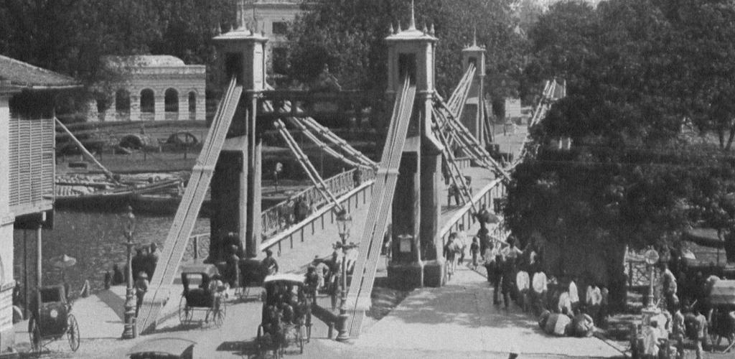
The Built Works Registry and the Infrastructure to Support it James Shulman

Slide 2
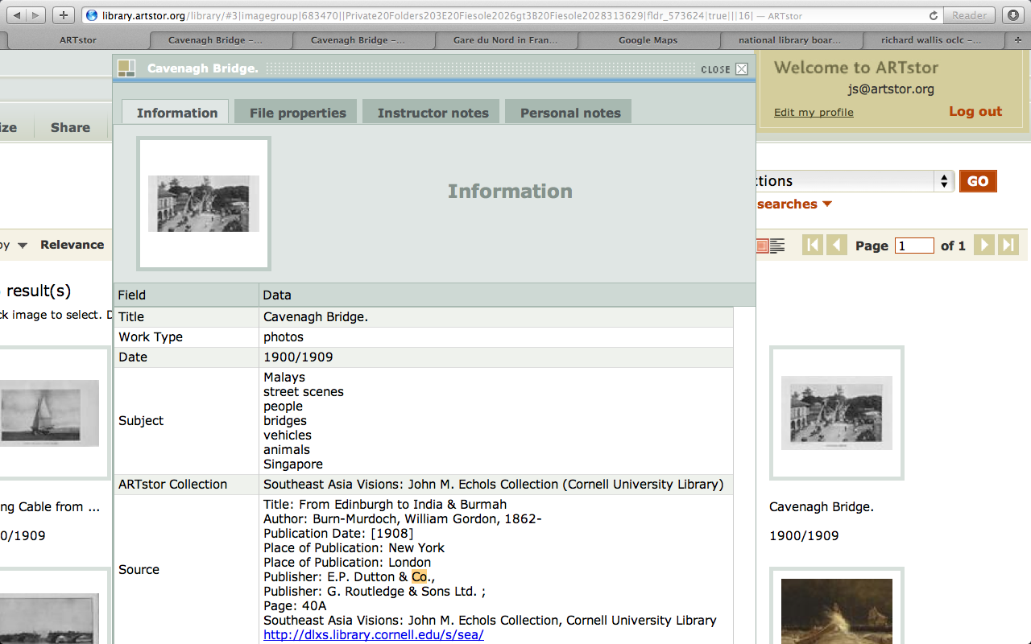

Slide 3
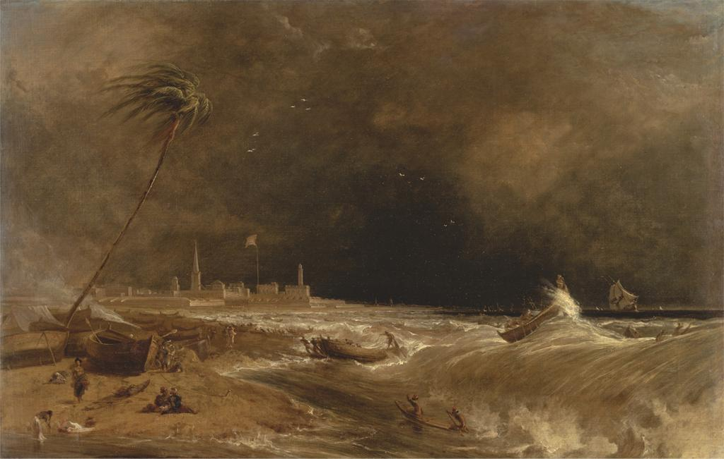
Notes:
Creator: William Daniell, 1769-1837, British Title: Madras, or Fort St. George, in the Bay of Bengal -- A Squall Passing Off Title: Approaching Storm, Madras Work Type: Painting Work Type: landscape; marine art Date: 1833 Material: Oil on canvas Measurements: 27 x 42 inches (68.6 x 106.7 cm) Description: No inscription Description: Signed and dated, lower left: "W. D. 1833." Repository: Yale Center for British Art, Paul Mellon Collection Accession Number: B1981.25.209 Related Item: Pauline Rohatgi, Indian life and landscape by Western artists, paintings and drawings from the Victoria and Albert Museum, 17th to the early 20th century, Chhatrapati Shivaji Maharaj Vastu Sangrahalaya, Mumbai, 2008, pp. 245-49, fig. 2, N8214.5 I5 V53 2008 + (YCBA); Morna O'Neill, Company culture, British artists and the East India Company 1770-1830 : October 16, 2003-January 11, 2004., Yale Center for British Art, New Haven, 2003, no. 25, V 1199 (YCBA); Mary Webster, Johan Zoffany, 1733-1810, Yale University Press, New Haven [Conn.], 2011, p. 451, fig. 338, NJ18 Z68 W43 2011 + (YCBA); Painting in England 1700-1850 from the Collection of Mr. and Mrs. Paul Mellon, The Royal Academy of Arts Winter Exhibition 1964-65., Royal Academy of Arts, London, UK, 1964, p. 49 (v.1), no. 179, ND466 R68 1964/65 (YCBA) , V. 2 is only available on MICROFICHE; See Fiche B214; Virginia Museum of Fine Arts, Painting in England 1700-1850, collection of Mr. & Mrs. Paul Mellon., Richmond, VA, 1963, p. 96 (v.1), no. 150, pl. 68, ND466 V57 v.1-2 (YCBA); Yale University Art Gallery, Painting in England, 1700-1850, from the collection of Mr. and Mrs. Paul Mellon, [exhibition at] Yale University Art Gallery, April 15-June 20, 1965., vol. 1, W. Clowes and sons, , 1965, p. 20 (v.1), no. 69, ND466 Y35 (YCBA); Catalogue of English pictures and drawings, Christie's, June 24, 1960, p. 26, no. 118, Sales Catalogue (YCBA) Related Item: http://collections.britishart.yale.edu/vufind/Record/1670837 Subject: Orientalism; wind; people; storm; waves; steeple; ocean; sea; shore (landform); tree; beach; lighthouse; boats; landscape; marines (visual works); church; fort; flag; Union Jack Collection: Yale Center for British Art Collection: http://britishart.yale.edu ID Number: 719 Source: Yale Center for British Art Rights: Rights: The Yale Center for British Art makes its photographic images of works believed to be in the public domain or with no known restrictions freely available. Please review the Center's image use terms here: Rights: http://britishart.yale.edu/collections/using-collections/image-use Rights: ARTstor does not seek to restrict the use of this image beyond the Center's terms; however, should there be any third-party copyrights in this image, and should you use this image beyond the ARTstor terms of use, you are solely responsible for any necessary third-party copyright clearances.

Slide 4
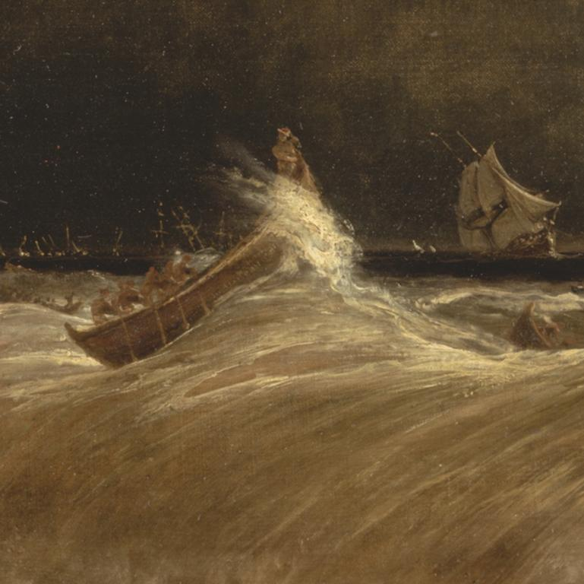
Notes:
Creator: William Daniell, 1769-1837, British Title: Madras, or Fort St. George, in the Bay of Bengal -- A Squall Passing Off Title: Approaching Storm, Madras Work Type: Painting Work Type: landscape; marine art Date: 1833 Material: Oil on canvas Measurements: 27 x 42 inches (68.6 x 106.7 cm) Description: No inscription Description: Signed and dated, lower left: "W. D. 1833." Repository: Yale Center for British Art, Paul Mellon Collection Accession Number: B1981.25.209 Related Item: Pauline Rohatgi, Indian life and landscape by Western artists, paintings and drawings from the Victoria and Albert Museum, 17th to the early 20th century, Chhatrapati Shivaji Maharaj Vastu Sangrahalaya, Mumbai, 2008, pp. 245-49, fig. 2, N8214.5 I5 V53 2008 + (YCBA); Morna O'Neill, Company culture, British artists and the East India Company 1770-1830 : October 16, 2003-January 11, 2004., Yale Center for British Art, New Haven, 2003, no. 25, V 1199 (YCBA); Mary Webster, Johan Zoffany, 1733-1810, Yale University Press, New Haven [Conn.], 2011, p. 451, fig. 338, NJ18 Z68 W43 2011 + (YCBA); Painting in England 1700-1850 from the Collection of Mr. and Mrs. Paul Mellon, The Royal Academy of Arts Winter Exhibition 1964-65., Royal Academy of Arts, London, UK, 1964, p. 49 (v.1), no. 179, ND466 R68 1964/65 (YCBA) , V. 2 is only available on MICROFICHE; See Fiche B214; Virginia Museum of Fine Arts, Painting in England 1700-1850, collection of Mr. & Mrs. Paul Mellon., Richmond, VA, 1963, p. 96 (v.1), no. 150, pl. 68, ND466 V57 v.1-2 (YCBA); Yale University Art Gallery, Painting in England, 1700-1850, from the collection of Mr. and Mrs. Paul Mellon, [exhibition at] Yale University Art Gallery, April 15-June 20, 1965., vol. 1, W. Clowes and sons, , 1965, p. 20 (v.1), no. 69, ND466 Y35 (YCBA); Catalogue of English pictures and drawings, Christie's, June 24, 1960, p. 26, no. 118, Sales Catalogue (YCBA) Related Item: http://collections.britishart.yale.edu/vufind/Record/1670837 Subject: Orientalism; wind; people; storm; waves; steeple; ocean; sea; shore (landform); tree; beach; lighthouse; boats; landscape; marines (visual works); church; fort; flag; Union Jack Collection: Yale Center for British Art Collection: http://britishart.yale.edu ID Number: 719 Source: Yale Center for British Art Rights: Rights: The Yale Center for British Art makes its photographic images of works believed to be in the public domain or with no known restrictions freely available. Please review the Center's image use terms here: Rights: http://britishart.yale.edu/collections/using-collections/image-use Rights: ARTstor does not seek to restrict the use of this image beyond the Center's terms; however, should there be any third-party copyrights in this image, and should you use this image beyond the ARTstor terms of use, you are solely responsible for any necessary third-party copyright clearances.

Slide 5
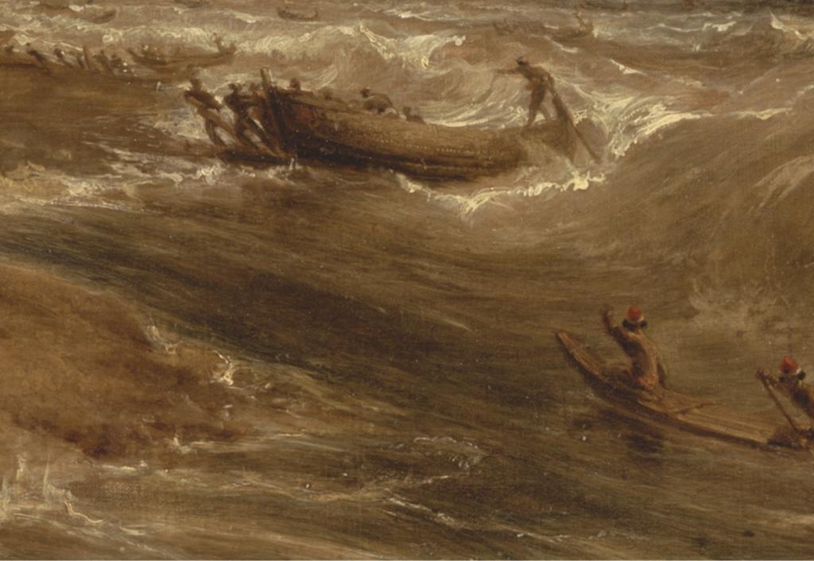
Notes:
Creator: William Daniell, 1769-1837, British Title: Madras, or Fort St. George, in the Bay of Bengal -- A Squall Passing Off Title: Approaching Storm, Madras Work Type: Painting Work Type: landscape; marine art Date: 1833 Material: Oil on canvas Measurements: 27 x 42 inches (68.6 x 106.7 cm) Description: No inscription Description: Signed and dated, lower left: "W. D. 1833." Repository: Yale Center for British Art, Paul Mellon Collection Accession Number: B1981.25.209 Related Item: Pauline Rohatgi, Indian life and landscape by Western artists, paintings and drawings from the Victoria and Albert Museum, 17th to the early 20th century, Chhatrapati Shivaji Maharaj Vastu Sangrahalaya, Mumbai, 2008, pp. 245-49, fig. 2, N8214.5 I5 V53 2008 + (YCBA); Morna O'Neill, Company culture, British artists and the East India Company 1770-1830 : October 16, 2003-January 11, 2004., Yale Center for British Art, New Haven, 2003, no. 25, V 1199 (YCBA); Mary Webster, Johan Zoffany, 1733-1810, Yale University Press, New Haven [Conn.], 2011, p. 451, fig. 338, NJ18 Z68 W43 2011 + (YCBA); Painting in England 1700-1850 from the Collection of Mr. and Mrs. Paul Mellon, The Royal Academy of Arts Winter Exhibition 1964-65., Royal Academy of Arts, London, UK, 1964, p. 49 (v.1), no. 179, ND466 R68 1964/65 (YCBA) , V. 2 is only available on MICROFICHE; See Fiche B214; Virginia Museum of Fine Arts, Painting in England 1700-1850, collection of Mr. & Mrs. Paul Mellon., Richmond, VA, 1963, p. 96 (v.1), no. 150, pl. 68, ND466 V57 v.1-2 (YCBA); Yale University Art Gallery, Painting in England, 1700-1850, from the collection of Mr. and Mrs. Paul Mellon, [exhibition at] Yale University Art Gallery, April 15-June 20, 1965., vol. 1, W. Clowes and sons, , 1965, p. 20 (v.1), no. 69, ND466 Y35 (YCBA); Catalogue of English pictures and drawings, Christie's, June 24, 1960, p. 26, no. 118, Sales Catalogue (YCBA) Related Item: http://collections.britishart.yale.edu/vufind/Record/1670837 Subject: Orientalism; wind; people; storm; waves; steeple; ocean; sea; shore (landform); tree; beach; lighthouse; boats; landscape; marines (visual works); church; fort; flag; Union Jack Collection: Yale Center for British Art Collection: http://britishart.yale.edu ID Number: 719 Source: Yale Center for British Art Rights: Rights: The Yale Center for British Art makes its photographic images of works believed to be in the public domain or with no known restrictions freely available. Please review the Center's image use terms here: Rights: http://britishart.yale.edu/collections/using-collections/image-use Rights: ARTstor does not seek to restrict the use of this image beyond the Center's terms; however, should there be any third-party copyrights in this image, and should you use this image beyond the ARTstor terms of use, you are solely responsible for any necessary third-party copyright clearances.

Slide 6
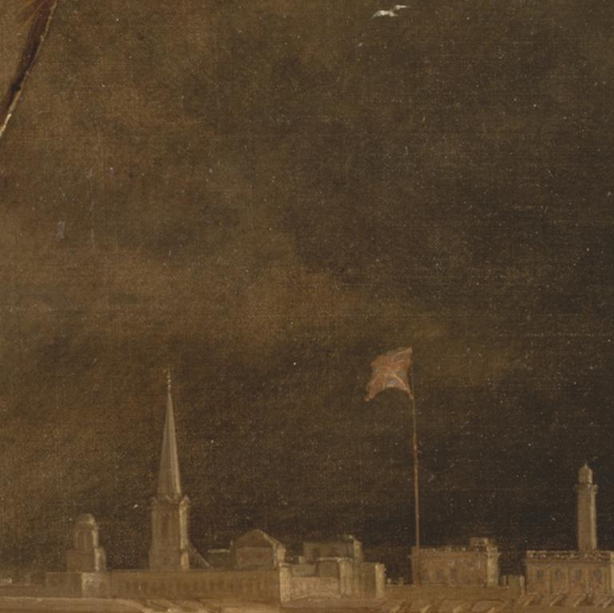
Notes:
Creator: William Daniell, 1769-1837, British Title: Madras, or Fort St. George, in the Bay of Bengal -- A Squall Passing Off Title: Approaching Storm, Madras Work Type: Painting Work Type: landscape; marine art Date: 1833 Material: Oil on canvas Measurements: 27 x 42 inches (68.6 x 106.7 cm) Description: No inscription Description: Signed and dated, lower left: "W. D. 1833." Repository: Yale Center for British Art, Paul Mellon Collection Accession Number: B1981.25.209 Related Item: Pauline Rohatgi, Indian life and landscape by Western artists, paintings and drawings from the Victoria and Albert Museum, 17th to the early 20th century, Chhatrapati Shivaji Maharaj Vastu Sangrahalaya, Mumbai, 2008, pp. 245-49, fig. 2, N8214.5 I5 V53 2008 + (YCBA); Morna O'Neill, Company culture, British artists and the East India Company 1770-1830 : October 16, 2003-January 11, 2004., Yale Center for British Art, New Haven, 2003, no. 25, V 1199 (YCBA); Mary Webster, Johan Zoffany, 1733-1810, Yale University Press, New Haven [Conn.], 2011, p. 451, fig. 338, NJ18 Z68 W43 2011 + (YCBA); Painting in England 1700-1850 from the Collection of Mr. and Mrs. Paul Mellon, The Royal Academy of Arts Winter Exhibition 1964-65., Royal Academy of Arts, London, UK, 1964, p. 49 (v.1), no. 179, ND466 R68 1964/65 (YCBA) , V. 2 is only available on MICROFICHE; See Fiche B214; Virginia Museum of Fine Arts, Painting in England 1700-1850, collection of Mr. & Mrs. Paul Mellon., Richmond, VA, 1963, p. 96 (v.1), no. 150, pl. 68, ND466 V57 v.1-2 (YCBA); Yale University Art Gallery, Painting in England, 1700-1850, from the collection of Mr. and Mrs. Paul Mellon, [exhibition at] Yale University Art Gallery, April 15-June 20, 1965., vol. 1, W. Clowes and sons, , 1965, p. 20 (v.1), no. 69, ND466 Y35 (YCBA); Catalogue of English pictures and drawings, Christie's, June 24, 1960, p. 26, no. 118, Sales Catalogue (YCBA) Related Item: http://collections.britishart.yale.edu/vufind/Record/1670837 Subject: Orientalism; wind; people; storm; waves; steeple; ocean; sea; shore (landform); tree; beach; lighthouse; boats; landscape; marines (visual works); church; fort; flag; Union Jack Collection: Yale Center for British Art Collection: http://britishart.yale.edu ID Number: 719 Source: Yale Center for British Art Rights: Rights: The Yale Center for British Art makes its photographic images of works believed to be in the public domain or with no known restrictions freely available. Please review the Center's image use terms here: Rights: http://britishart.yale.edu/collections/using-collections/image-use Rights: ARTstor does not seek to restrict the use of this image beyond the Center's terms; however, should there be any third-party copyrights in this image, and should you use this image beyond the ARTstor terms of use, you are solely responsible for any necessary third-party copyright clearances.

Slide 7
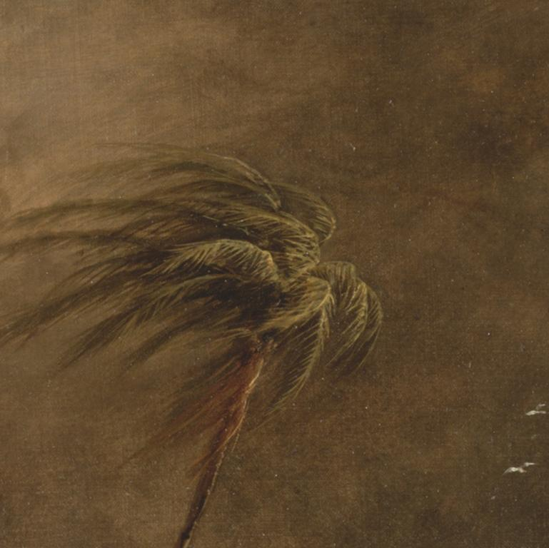
Notes:
Creator: William Daniell, 1769-1837, British Title: Madras, or Fort St. George, in the Bay of Bengal -- A Squall Passing Off Title: Approaching Storm, Madras Work Type: Painting Work Type: landscape; marine art Date: 1833 Material: Oil on canvas Measurements: 27 x 42 inches (68.6 x 106.7 cm) Description: No inscription Description: Signed and dated, lower left: "W. D. 1833." Repository: Yale Center for British Art, Paul Mellon Collection Accession Number: B1981.25.209 Related Item: Pauline Rohatgi, Indian life and landscape by Western artists, paintings and drawings from the Victoria and Albert Museum, 17th to the early 20th century, Chhatrapati Shivaji Maharaj Vastu Sangrahalaya, Mumbai, 2008, pp. 245-49, fig. 2, N8214.5 I5 V53 2008 + (YCBA); Morna O'Neill, Company culture, British artists and the East India Company 1770-1830 : October 16, 2003-January 11, 2004., Yale Center for British Art, New Haven, 2003, no. 25, V 1199 (YCBA); Mary Webster, Johan Zoffany, 1733-1810, Yale University Press, New Haven [Conn.], 2011, p. 451, fig. 338, NJ18 Z68 W43 2011 + (YCBA); Painting in England 1700-1850 from the Collection of Mr. and Mrs. Paul Mellon, The Royal Academy of Arts Winter Exhibition 1964-65., Royal Academy of Arts, London, UK, 1964, p. 49 (v.1), no. 179, ND466 R68 1964/65 (YCBA) , V. 2 is only available on MICROFICHE; See Fiche B214; Virginia Museum of Fine Arts, Painting in England 1700-1850, collection of Mr. & Mrs. Paul Mellon., Richmond, VA, 1963, p. 96 (v.1), no. 150, pl. 68, ND466 V57 v.1-2 (YCBA); Yale University Art Gallery, Painting in England, 1700-1850, from the collection of Mr. and Mrs. Paul Mellon, [exhibition at] Yale University Art Gallery, April 15-June 20, 1965., vol. 1, W. Clowes and sons, , 1965, p. 20 (v.1), no. 69, ND466 Y35 (YCBA); Catalogue of English pictures and drawings, Christie's, June 24, 1960, p. 26, no. 118, Sales Catalogue (YCBA) Related Item: http://collections.britishart.yale.edu/vufind/Record/1670837 Subject: Orientalism; wind; people; storm; waves; steeple; ocean; sea; shore (landform); tree; beach; lighthouse; boats; landscape; marines (visual works); church; fort; flag; Union Jack Collection: Yale Center for British Art Collection: http://britishart.yale.edu ID Number: 719 Source: Yale Center for British Art Rights: Rights: The Yale Center for British Art makes its photographic images of works believed to be in the public domain or with no known restrictions freely available. Please review the Center's image use terms here: Rights: http://britishart.yale.edu/collections/using-collections/image-use Rights: ARTstor does not seek to restrict the use of this image beyond the Center's terms; however, should there be any third-party copyrights in this image, and should you use this image beyond the ARTstor terms of use, you are solely responsible for any necessary third-party copyright clearances.

Slide 8
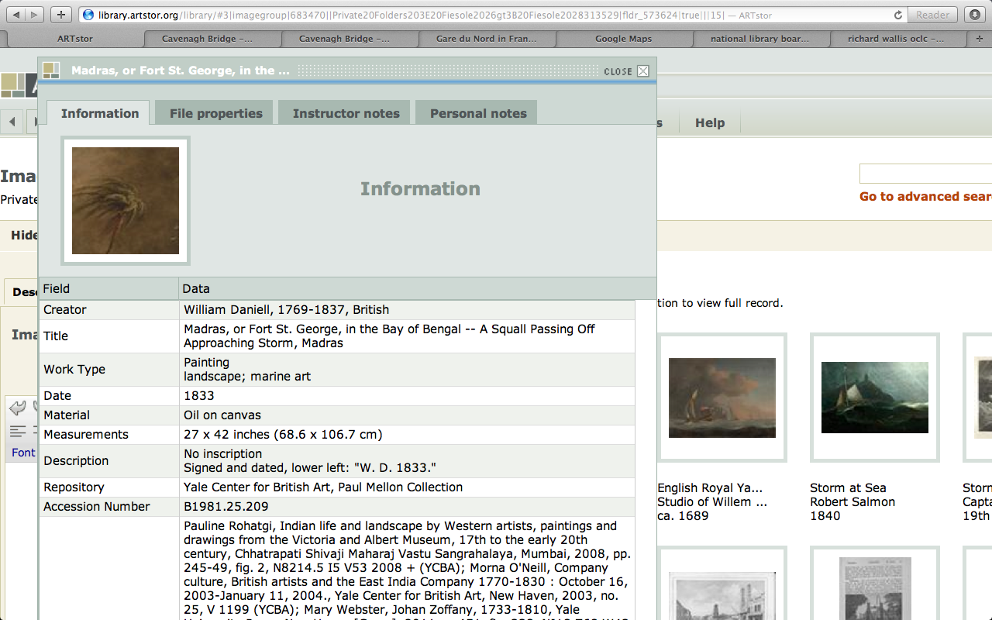

Slide 9
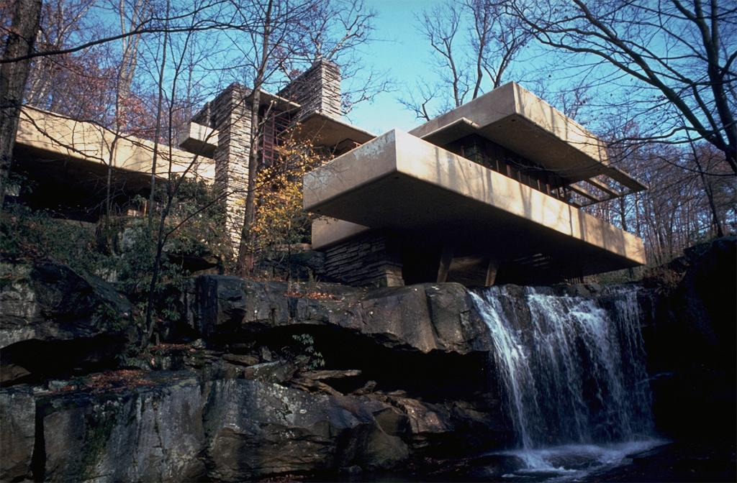
Sample problem:
Core data
Falling Water or Fallingwater
Kaufmann or Kauffman House
Edgar J. Kaufmann Sr. Residence or Kaufmann Desert House
Frank Lloyd Wright or Richard Neutra ?
Mill Run or Bear Run?
Enhanced data
Geo-code
Dates
View
Type

Slide 10
Sample data

Slide 11
Sample data

Slide 12
Sample data

Slide 13
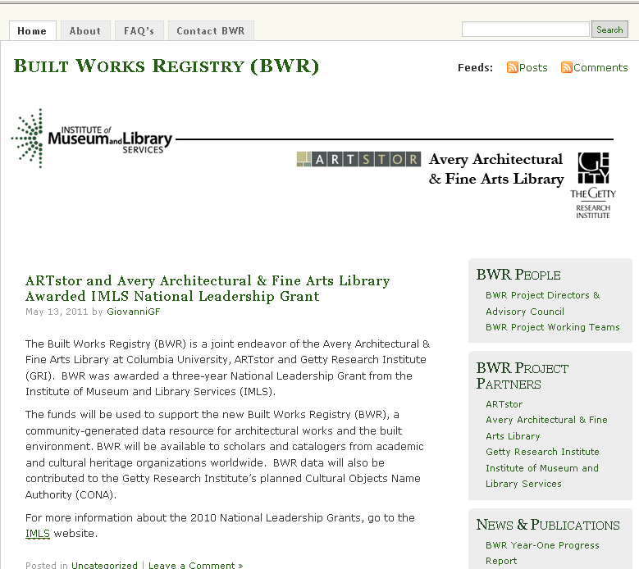
http://builtworksregistry.wordpress.com/

Slide 14
BWR partnership
“New partnerships will result from collaboration and coordination among a wide array of stakeholders. This will realize workflow efficiencies and minimize redundancies between and among entities that create and use both authority and bibliographic data…”
Report of the LC Working Group on the Future of Bibliographic Control (2008)

Slide 15
BWR project goals
Construct a registry for architectural works and the built environment
Develop unique IDs & trusted data records for registered works
Reduce redundancy by providing a networked source of authoritative data
Develop a collaborative community plan to seed, build upon and edit a shared record

Slide 16
Policies
Project partners +
BWR Advisory Council
Canada, Germany, India, Italy, Japan, Taiwan, Turkey, UK, US
18 scholars, curators, librarians, & technologists representing diverse specializations in academic & cultural institutions:
Museums: MoMA, AIC, Smithsonian, National Palace Museum Taipei
Libraries: Columbia, Cornell, Harvard, Yale, NYU, Colby, UMiami, Illinois
Research institutes: Courtauld, Max Planck, Inst. For Museum Research
Organizations: RIBA, World Monuments Fund, SAH, IFLA
Notes:
Founders Agreement
Joint ownership of BWR records
Establishes BWR standing committee
Succession plan
Contributor Agreements
Institutional contributions
Individual contributors

Slide 17
ARTstor Digital Library Today
Founded by The Andrew W. Mellon Foundation in 2001
Independent nonprofit organization since 2003
Launched in July 1, 2004
1.6 million images and growing
200+ museum & special collections
Museums, archives, libraries, artists, artists’ estates, scholars, photographers
Password-protected database restricted to educational and scholarly users
Notes:
Jan VermeerTitleThe Painter and his Model as KlioDate1665-1666Materialoil on canvasMeasurements120 x 100 cmRepositoryKunsthistorisches Museum ViennaARTstor CollectionArt, Archaeology and Architecture (Erich Lessing Culture and Fine Arts Archives)ID Number40-03-01/50SourceImage and original data provided by Erich Lessing Culture and Fine Arts Archives/ART RESOURCE, N.Y. http://www.artres.com/c/htm/Home.aspx http://www.artres.com/c/htm/TreePfLight.aspx?ID=LES

Slide 18
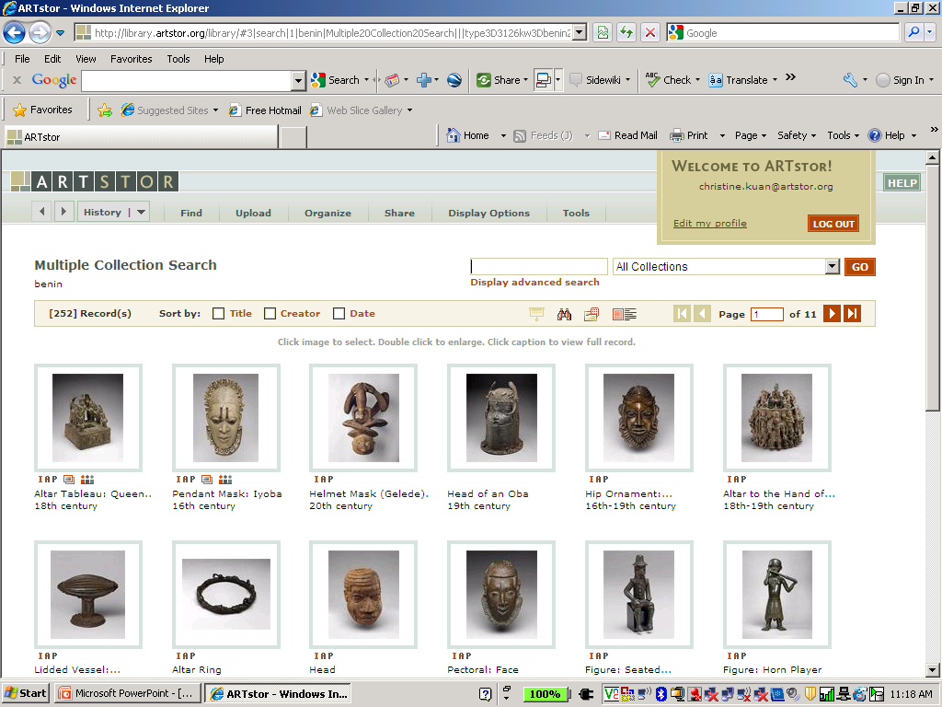
Associated images – What are instructors teaching?
Associated
Images

Slide 19
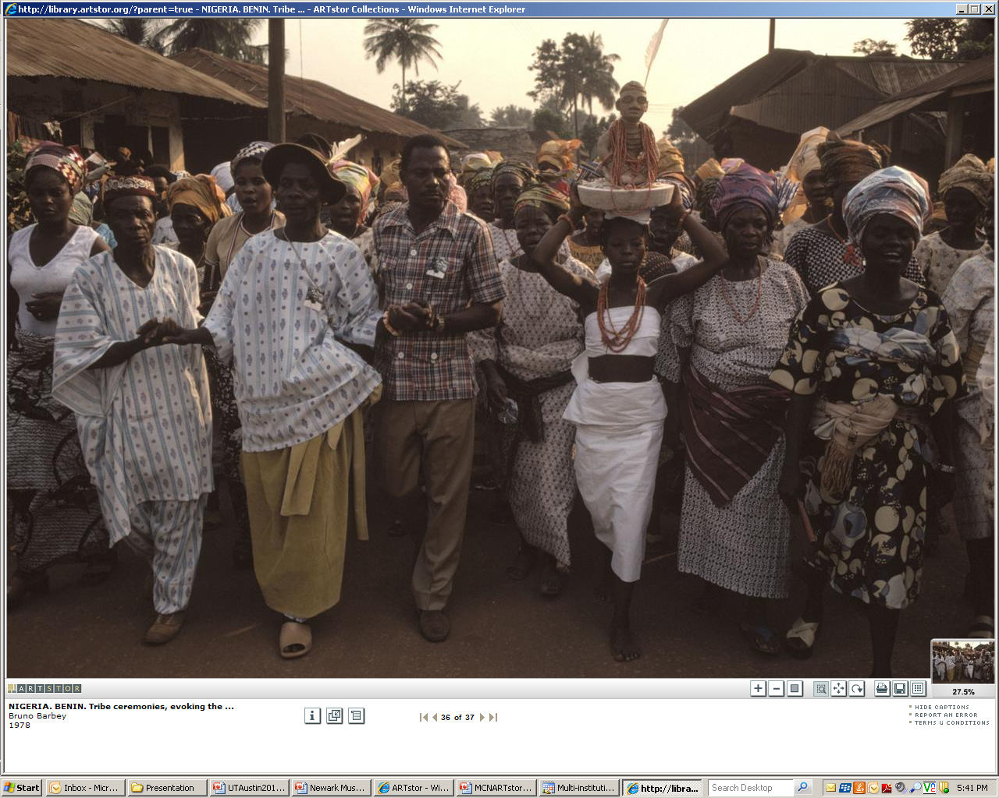
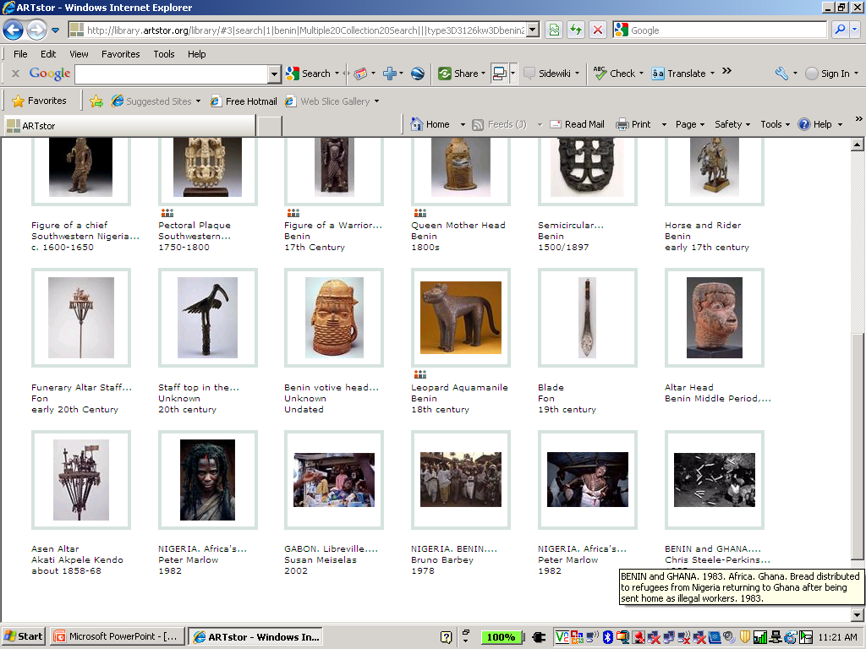
Discover related images

Slide 20
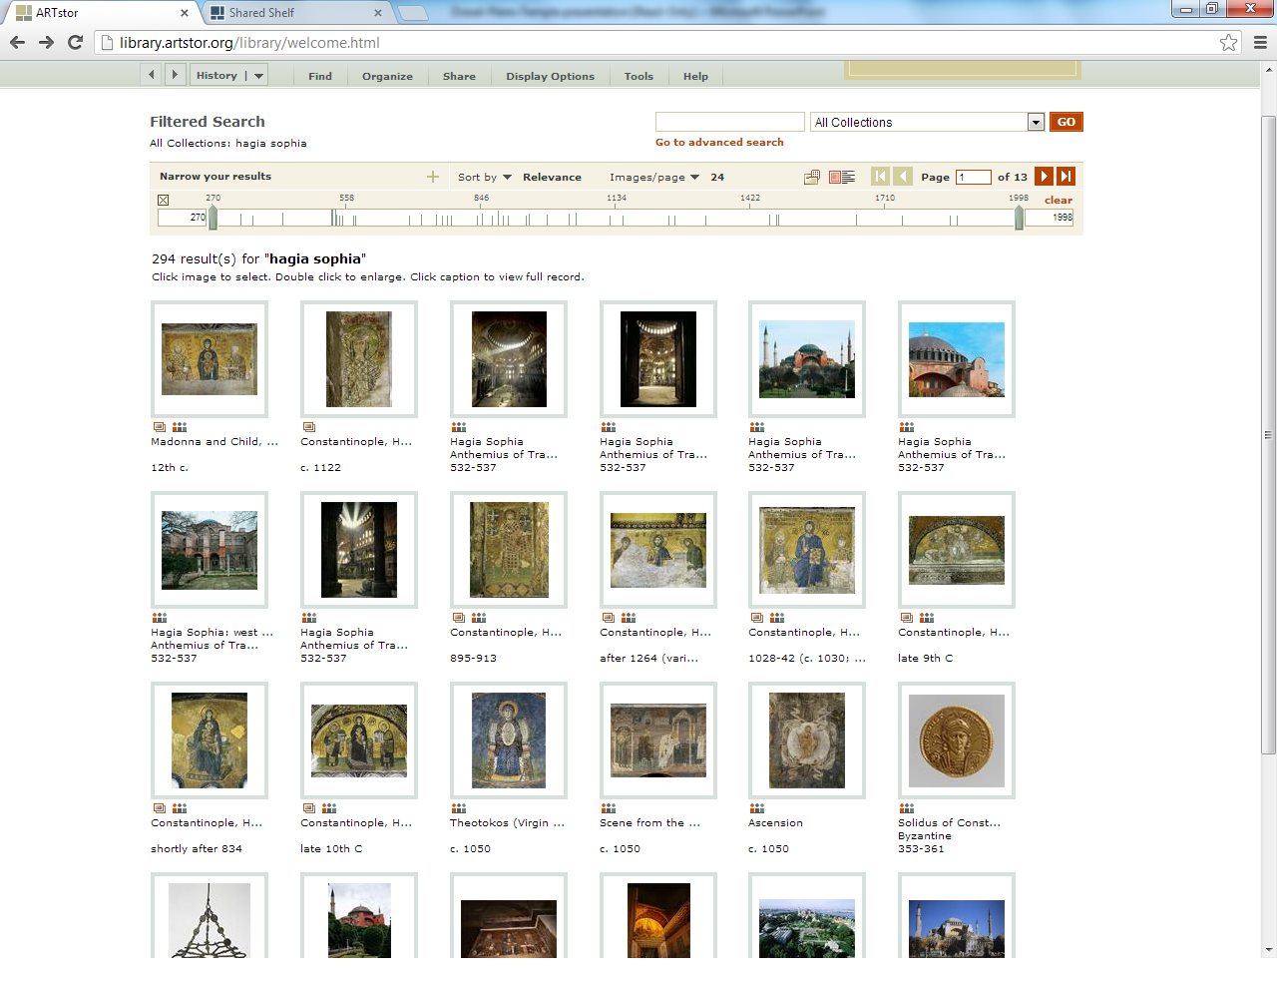
Hagia Sophia screen shot

Slide 21
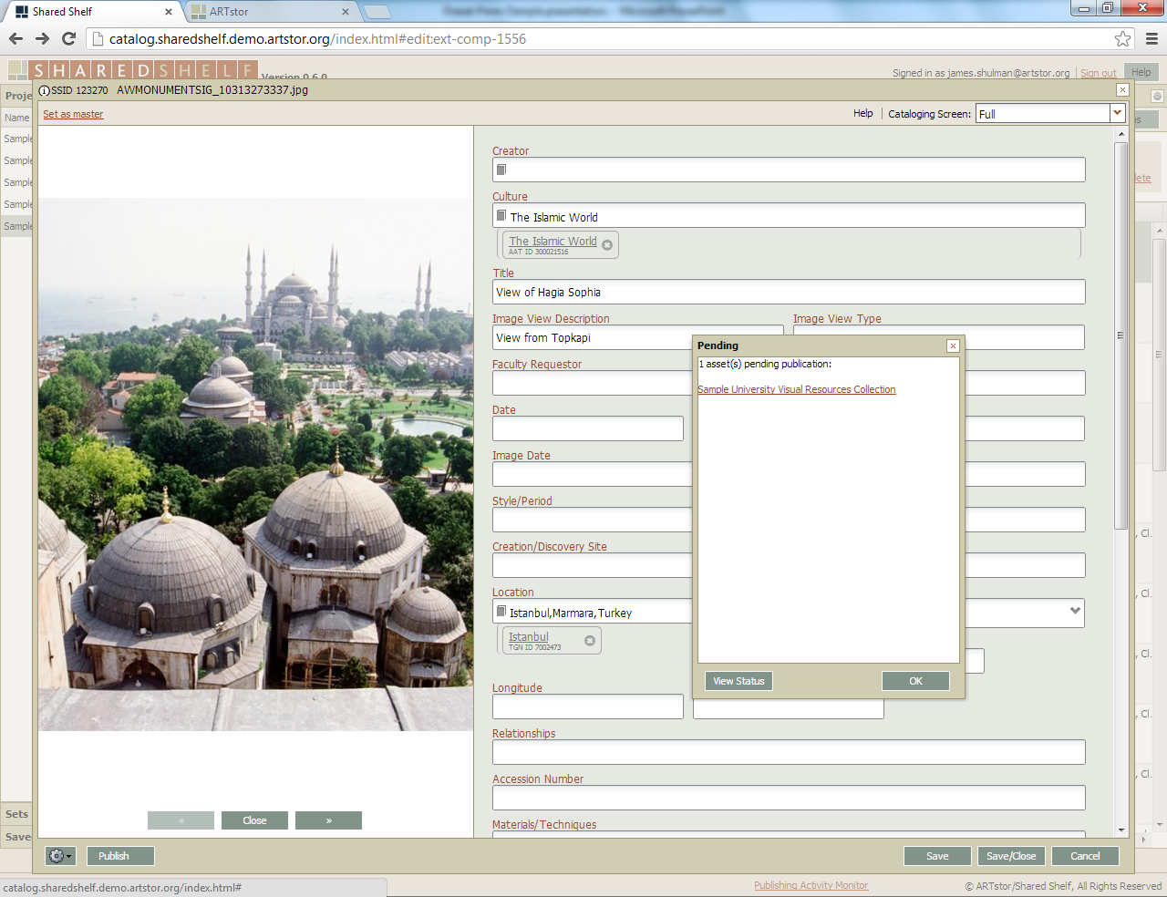

Slide 22
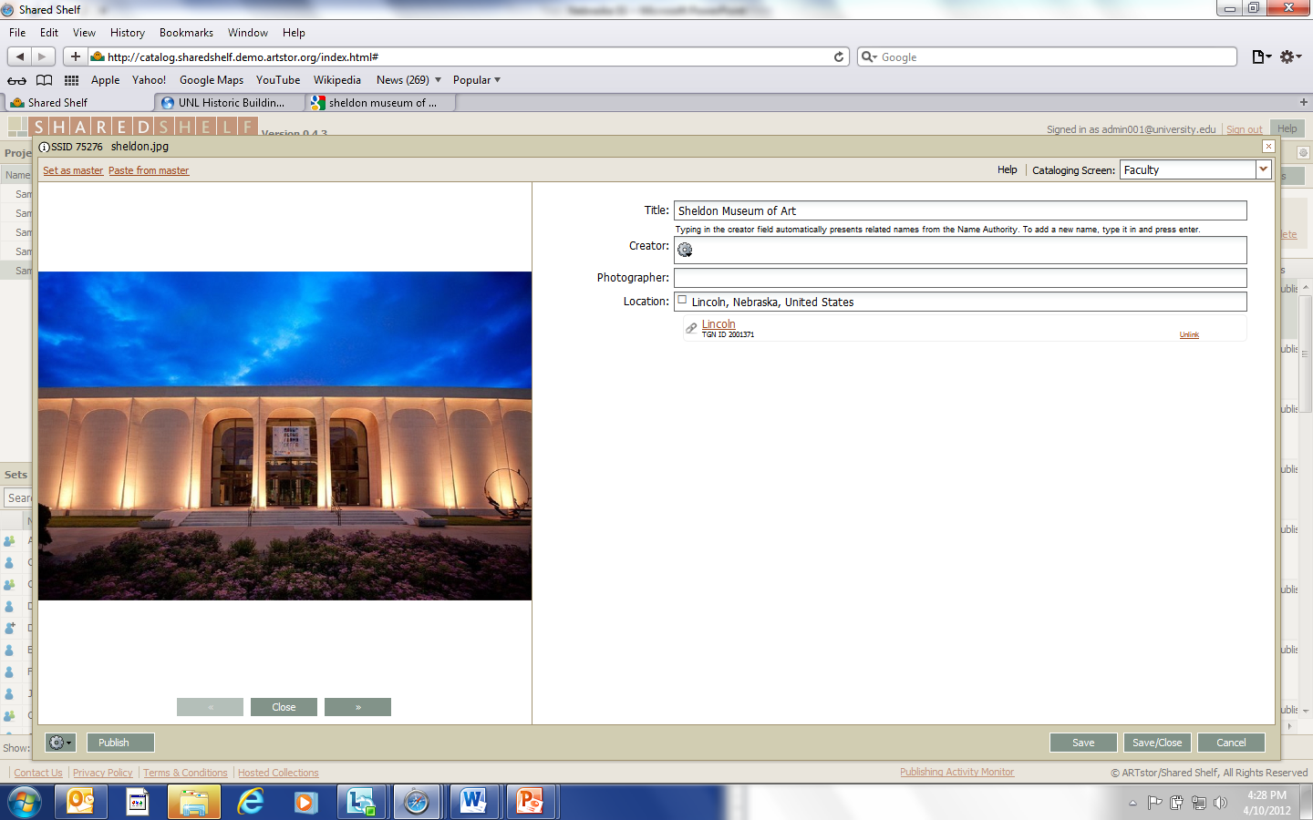
Simple Cataloging Screens
Featuring the Getty’s ULAN & TGN vocabularies
Notes:
Metadata schemas and cataloging screens are completely customizable. Full size, zoomable images available during cataloging. Draw upon integrated Getty vocabularies or add your own vocabulary values and share with the community. Download the full size source image at any time.

Slide 23
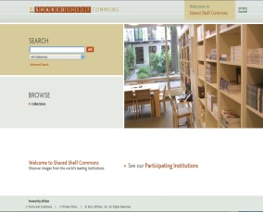
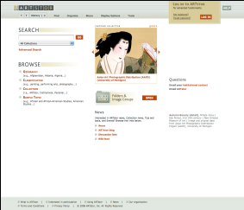
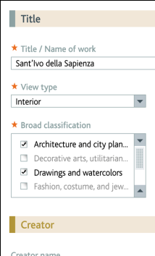
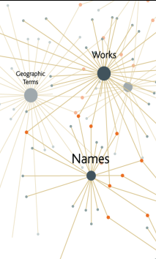
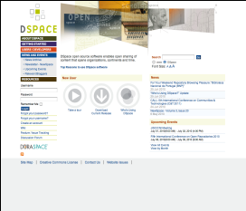
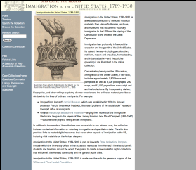
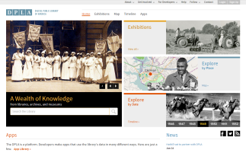
Local Content and Shared Shelf Infrastructure
Shared Shelf Commons
Mixing local & ARTstor content
Cataloging
environment
Shared vocabularies
Cloud
Computing
Institutional
repository (API)
Asset
management
API
Web exhibitions (future)
DPLA
Notes:
Harnessing the power of cloud computing
-Content going into cloud (remotely stored), can get content out of cloud
-Components don’t live locally, can be released directly from the cloud to end users using standard web browsers
-You don’t have to worry about supporting infrastructure, servers. Everything is handled remotely.

Slide 24
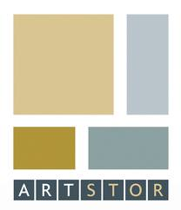
Content
AVIADOR
Videodisc Index

Slide 25
BWR ‘seed’ content
Goal: registry of ~100,000 unique identified built works
Identify, extract, & verify data from five sources:
Harvard’s Olivia 2.5M > 392,917 > 55,621
Cornell’s Pictor 24K > 13,847 > 1,611
Avery’s AVIADOR 40K > 4,878
Avery Index 650K records = subject term strings ~433,131
ARTstor 1.4M records = built work image records ~70,000

Slide 26
Content development
Aggregate
Disambiguate
Normalize
Enhance
CONA merge tools: Loader & Processor
ARTstor parsing tools
Google Refine

Slide 27
Field Name | AVIADOR | Harvard | Cornell | Avery | ARTstor
Title/Name of Building | Fallingwater, Kaufmann House | Fallingwater, Edgar J. Kaufmann House, Kaufmann House | Falling Water, Edgar J. Kaufmann Residence | Fallingwater (Kaufmann house). | Fallingwater, Edgar J. Kaufmann House, Kaufmann House
Location | Bear Run, (Pa.) | Bear Run, Pennsylvania, United States | Bear Run, PA, United States, North and Central America | Bear Run (Pennsylvania), United States | Mill Run, Pennsylvania, United States
Creator | Wright, Frank Lloyd One record with Ferriss, Hugh | Wright, Frank Lloyd | Wright, Frank Lloyd | Wright, Frank Lloyd | Wright, Frank Lloyd
Date |  | 1935-1939 | 1934-1938 |  | 1935-1936
Work Type | Vacation houses, Houses, Country Houses | houses | House |  | House
Style/Period |  |  | Modern |  | Modernist
Subject |  | Summer houses; vacation houses; terrace houses; hillside architecture | Houses |  | Dwellings, Houses, Cantilevers, Waterfalls, Architecture—United States, National Historic Landmarks Program (U.S.), Architecture, Modern—20th century, Kaufmann, Edgar J., 1885-1955
Culture |  | American | American
Description |  |  | Modern Architecture
Other names |  | Kaufmann, Edgar J. (patron)

Slide 28
Disambiguate criteria
We all know that if two records both have “Notre Dame” and “France” is not sufficient to de-duplicate these two records.
Is “Notre Dame” and “Paris, France” sufficient?
The question is how “granular” do we need to go to gain confidence in “automatic” de-duplication.
We hope to report on our results in the next CNI meeting.

Slide 29
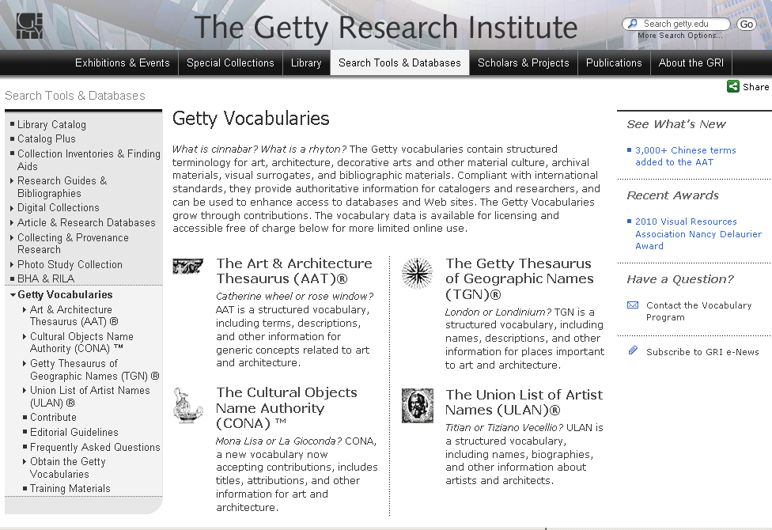
Authority

Slide 30
How will BWR gain scale?
Institutional contributory model
Governed by policy framework
Accessed through shared technical infrastructure
Web-based data entry environment
Ubiquitous network (Cloud)
Shared via open APIs
Expert crowdsourcing experiment
Community-driven approach to shared solutions
Controlled by role-based access control system

Slide 31
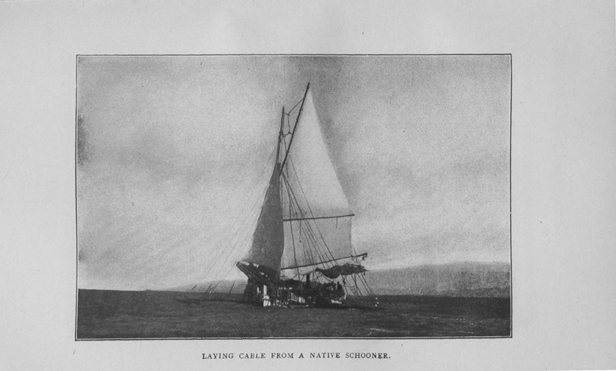
The Built Works Registry and the Infrastructure to Support it
James Shulman
From, Philippine life in town and country: 1905.

Slide 32
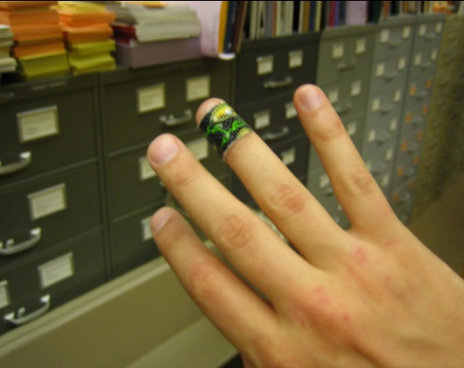
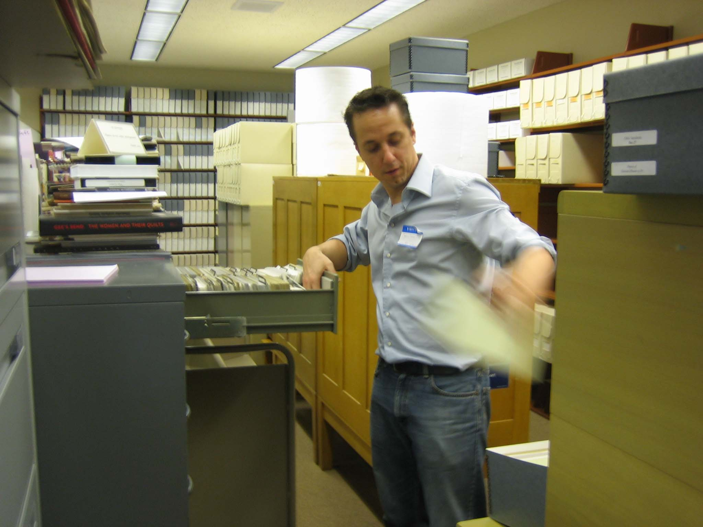
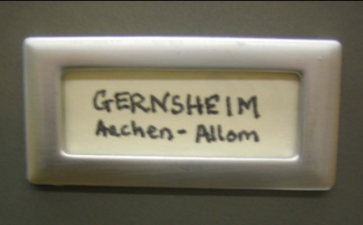
Gernsheim Photographic Corpus of Drawings
Page 32
Notes:
City, August 1, 2006 | Title | 32

Slide 33
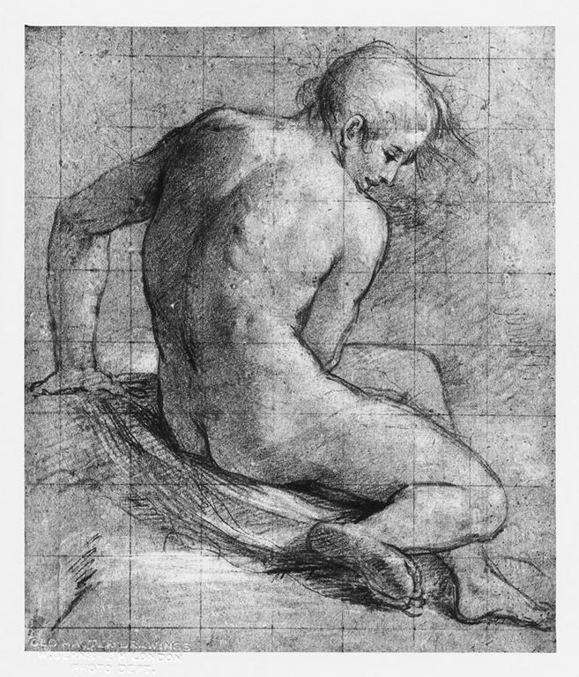
Notes:
Creator: Federico Barocci (1528-1612) Title: Nude seated, seen from behind Material: black chalk heightened with white on blue paper, squared Measurements: 313:00;266 mm Repository: British Museum. Dept. of Prints and Drawings Repository: http://www.britishmuseum.org/ Collection: Gernsheim Photographic Corpus of Drawings ID Number: 348 Source: Image and original data provided by the Gernsheim Photographic Corpus of Drawings established in 1937 Rights: Please note that if this image is under copyright, you may need to contact one or more copyright owners for any use that is not permitted under the ARTstor Terms and Conditions of Use or not otherwise permitted by law. While ARTstor tries to update contact information, it cannot guarantee that such information is always accurate. Determining whether those permissions are necessary, and obtaining such permissions, is your sole responsibility.

Slide 34
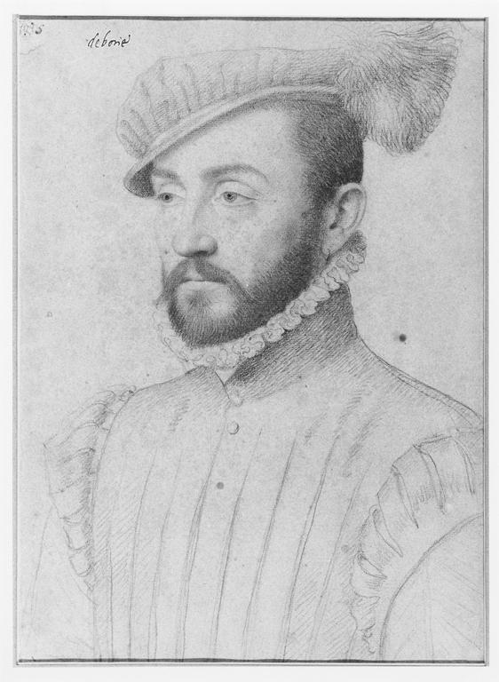
Notes:
Creator: François Clouet (ca. 1516-1572) Title: Portrait 'De Boisy' Material: black and colored chalks Measurements: 310 x 218 mm Repository: Fogg Art Museum; 1946.5 Repository: http://www.artmuseums.harvard.edu/fogg/ Collection: Gernsheim Photographic Corpus of Drawings ID Number: 91590 Source: Image and original data provided by the Gernsheim Photographic Corpus of Drawings established in 1937 Rights: Please note that if this image is under copyright, you may need to contact one or more copyright owners for any use that is not permitted under the ARTstor Terms and Conditions of Use or not otherwise permitted by law. While ARTstor tries to update contact information, it cannot guarantee that such information is always accurate. Determining whether those permissions are necessary, and obtaining such permissions, is your sole responsibility.

Slide 35
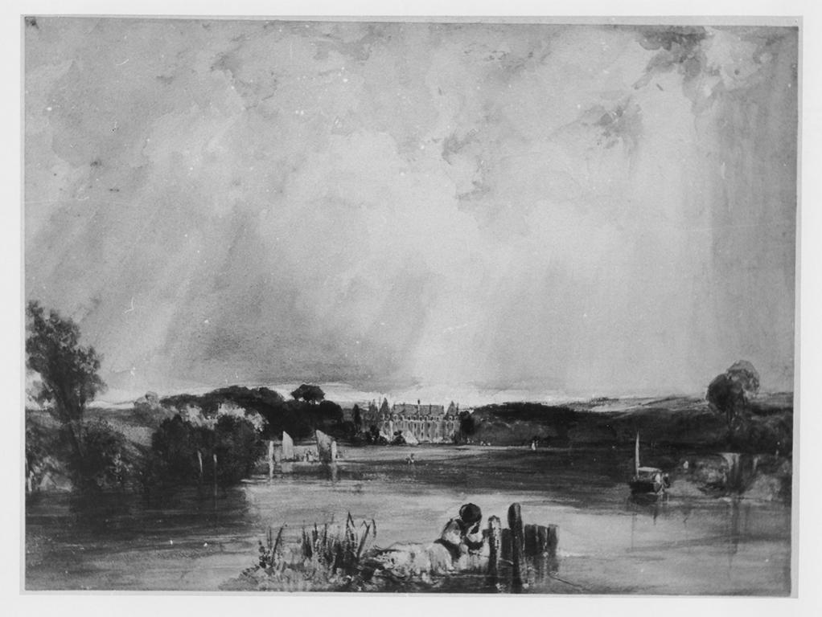
Notes:
Creator: Richard Parkes Bonington (1802-1828) Title: River scene - the Château of the Duchesse de Berry at Rosny Date: 1825 Material: watercolour and bodycolour Measurements: 203 x 272 mm Description: See "London - World City 1800-1840" catalogue of an exhibition in Essen, 1992, No 245. Repository: British Museum Dept. of Prints and Drawings, 1910-2-12-223 Repository: http://www.britishmuseum.org/ Collection: Gernsheim Photographic Corpus of Drawings ID Number: 13065 Source: Image and original data provided by the Gernsheim Photographic Corpus of Drawings established in 1937 Rights: Please note that if this image is under copyright, you may need to contact one or more copyright owners for any use that is not permitted under the ARTstor Terms and Conditions of Use or not otherwise permitted by law. While ARTstor tries to update contact information, it cannot guarantee that such information is always accurate. Determining whether those permissions are necessary, and obtaining such permissions, is your sole responsibility.

Slide 36
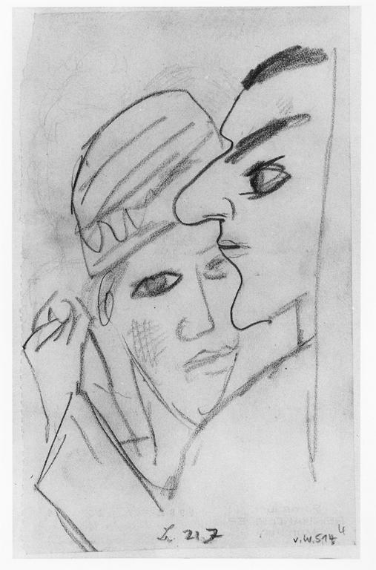
Notes:
Creator: Max Beckmann (1884-1950) Title: Heads of a dancing couple Date: 1922 Material: graphite Measurements: 159 x 96 mm Description: Signed with artist's monogram and dated "21.7" Bears collector mark of Reinhard Piper on verso ('Sammlung Reinhard Piper München'', undescribed in Lugt). Repository: British Museum. Dept. of Prints and Drawings, 1981-7-25-39 Repository: http://www.britishmuseum.org/ Collection: Gernsheim Photographic Corpus of Drawings ID Number: 119876 Source: Image and original data provided by the Gernsheim Photographic Corpus of Drawings established in 1937 Rights: Please note that if this image is under copyright, you may need to contact one or more copyright owners for any use that is not permitted under the ARTstor Terms and Conditions of Use or not otherwise permitted by law. While ARTstor tries to update contact information, it cannot guarantee that such information is always accurate. Determining whether those permissions are necessary, and obtaining such permissions, is your sole responsibility.

Slide 37
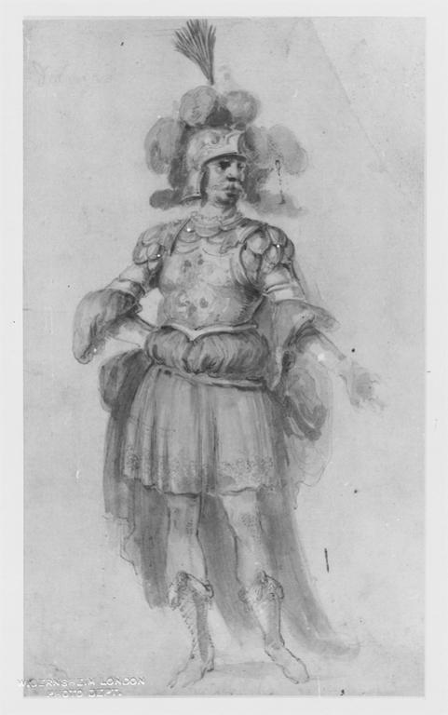
Notes:
Creator: Stefano della Bella (1610-1664) Title: Costume study for Delmiro Material: graphite, with watercolour and some pen and brown ink Measurements: 302 x 180 mm Description: Formerly in an album. The album once contained sixty-three drawings by Stefano della Bella, of costume designs, which are now mounted. On the front cover of the album are the arms of Cardinal Giovanni Carlo de' Medici and on the back those of the Accademia degli Immobili. The Academy was founded in 1649 by a group of Florentine noblemen who put on, and took part in, plays in their own theatre, the Teatro della Pergola (See P. Dearborn Massar, 'Costume Drawings by Stefano della Bella for the Florentine Theater', "Master Drawings", VIII, 3, 1970, pp.243-266). Description: Inscribed: "delmiro" Repository: British Museum. Dept. of Prints and Drawings, 1887-5-2-48 Repository: http://www.britishmuseum.org/ Collection: Gernsheim Photographic Corpus of Drawings ID Number: 4783 Source: Image and original data provided by the Gernsheim Photographic Corpus of Drawings established in 1937 Rights: Please note that if this image is under copyright, you may need to contact one or more copyright owners for any use that is not permitted under the ARTstor Terms and Conditions of Use or not otherwise permitted by law. While ARTstor tries to update contact information, it cannot guarantee that such information is always accurate. Determining whether those permissions are necessary, and obtaining such permissions, is your sole responsibility.

Slide 38
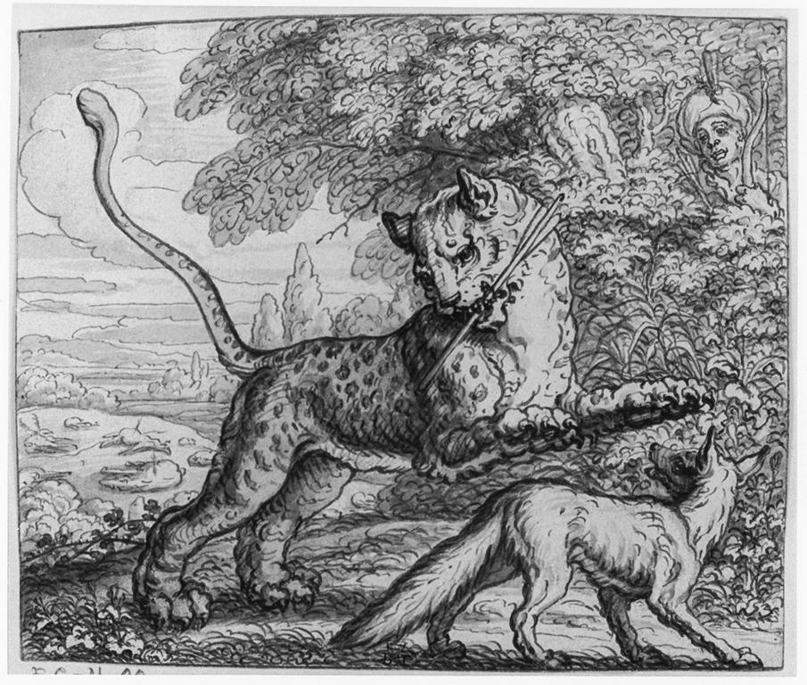
Notes:
Creator: Francis Barlow (ca. 1626-1704) Title: Illustration to Aesop's Fables with his life; Fable XXXI, 'The tygre and fox' Material: pen and brown ink, with grey wash Measurements: 129 x 160 mm Description: Drawing from an album bound in white vellum gilt (approx. 85 drawings in series). Etched by Barlow, in reverse (first published in Aesop's Fables, 1666 edition), with modifications. See LS & CW, No's 103-108 for further bibliographical references. Found with: 1858,0626.372-407; 1867,0413.320-395; 1855,0714.66. The drawing for Fable XXXII, 'The lioness and fox' is missing. Repository: British Museum. Dept. of Prints and Drawings, 1867-4-13-364 Repository: http://www.britishmuseum.org/ Collection: Gernsheim Photographic Corpus of Drawings ID Number: 129744 Source: Image and original data provided by the Gernsheim Photographic Corpus of Drawings established in 1937 Rights: Please note that if this image is under copyright, you may need to contact one or more copyright owners for any use that is not permitted under the ARTstor Terms and Conditions of Use or not otherwise permitted by law. While ARTstor tries to update contact information, it cannot guarantee that such information is always accurate. Determining whether those permissions are necessary, and obtaining such permissions, is your sole responsibility.

Slide 39
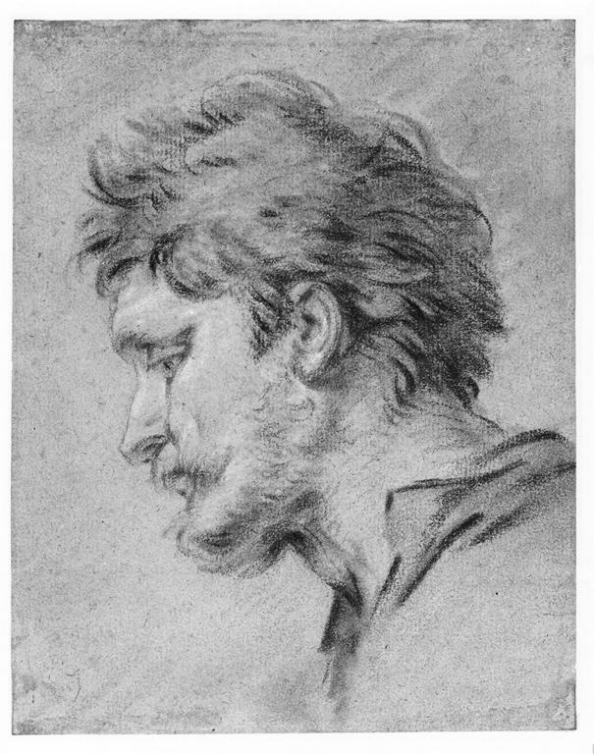
Notes:
Creator: François Boucher (1703-1770) Title: Head of a shepherd; study for an altarpiece Material: red, black and blue chalk, heightened with white; on brown paper Measurements: 186 x 145 mm Description: Study for the altarpiece, The Nativity, at the Oratory of Mme de Pompadour, Chateau de Bellevue. Repository: British Museum Dept. of Prints and Drawings, 1963-12-14-4; British Museum Dept. of Prints and Drawings, 1946-7-13-279; British Museum Dept. of Prints and Drawings, 1853-8-13-25; British Museum Dept. of Prints and Drawings, 1946-7-13-279 Repository: http://www.britishmuseum.org/ Collection: Gernsheim Photographic Corpus of Drawings ID Number: 109989 Source: Image and original data provided by the Gernsheim Photographic Corpus of Drawings established in 1937 Rights: Please note that if this image is under copyright, you may need to contact one or more copyright owners for any use that is not permitted under the ARTstor Terms and Conditions of Use or not otherwise permitted by law. While ARTstor tries to update contact information, it cannot guarantee that such information is always accurate. Determining whether those permissions are necessary, and obtaining such permissions, is your sole responsibility.

Slide 40
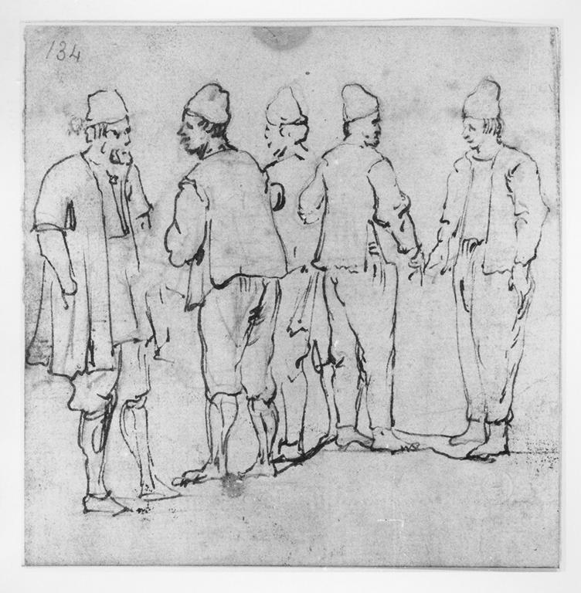
Notes:
Creator: Luca Carlevariis (1663-1729) Title: Group of male figures Material: pen over black chalk Measurements: 125 x 123 mm Repository: Victoria and Albert Museum. Dept. of Prints and Drawings; D. 1089-1900 Repository: http://www.vam.ac.uk/ Collection: Gernsheim Photographic Corpus of Drawings ID Number: 54501 Source: Image and original data provided by the Gernsheim Photographic Corpus of Drawings established in 1937 Rights: Please note that if this image is under copyright, you may need to contact one or more copyright owners for any use that is not permitted under the ARTstor Terms and Conditions of Use or not otherwise permitted by law. While ARTstor tries to update contact information, it cannot guarantee that such information is always accurate. Determining whether those permissions are necessary, and obtaining such permissions, is your sole responsibility.

Slide 41
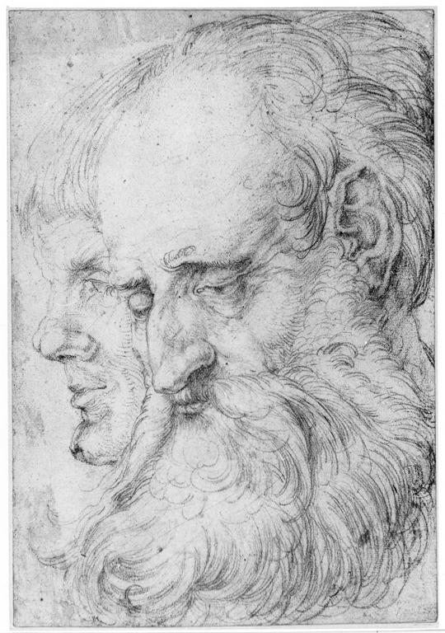
Notes:
Creator: Hans Baldung (1484/1485-1545); Hans Schäufelein the elder (ca. 1482-1539/1540) Title: Study of the heads of two men Date: 1512-1516 Material: red chalk, over black chalk Measurements: 288 x 201 mm Description: Lit: Michael Roth, 'Dürer's Mutter: Schönheit, Alter und Tod im Bild der Renaissance', exh.cat. Berlin, Kupferstichkabinett, 2006, no. 61 Repository: British Museum. Dept. of Prints and Drawings, 1949-4-11-106 Repository: http://www.britishmuseum.org/ Collection: Gernsheim Photographic Corpus of Drawings ID Number: 28755 Source: Image and original data provided by the Gernsheim Photographic Corpus of Drawings established in 1937 Rights: Please note that if this image is under copyright, you may need to contact one or more copyright owners for any use that is not permitted under the ARTstor Terms and Conditions of Use or not otherwise permitted by law. While ARTstor tries to update contact information, it cannot guarantee that such information is always accurate. Determining whether those permissions are necessary, and obtaining such permissions, is your sole responsibility.

Slide 42
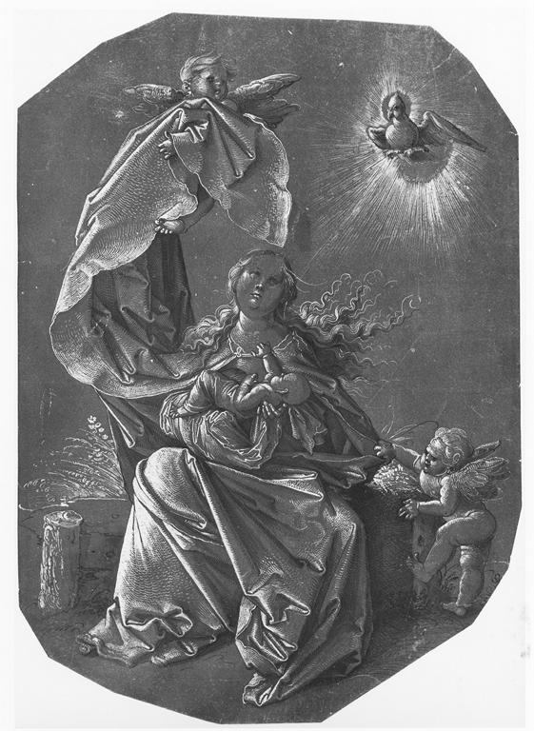
Notes:
Creator: Hans Baldung (1484/1485-1545) Title: The Virgin and Child seated on a bank, with two attendant angels Date: 1515-1520 Material: pen and black ink, heightened with white; on dark brown prepared paper Measurements: 279 x 195 mm Description: Inscribed by an early hand with Dürer's monogram and the date: "1518" Repository: British Museum. Dept. of Prints and Drawings, SL-5218-179 Repository: http://www.britishmuseum.org/ Collection: Gernsheim Photographic Corpus of Drawings ID Number: 28732 Source: Image and original data provided by the Gernsheim Photographic Corpus of Drawings established in 1937 Rights: Please note that if this image is under copyright, you may need to contact one or more copyright owners for any use that is not permitted under the ARTstor Terms and Conditions of Use or not otherwise permitted by law. While ARTstor tries to update contact information, it cannot guarantee that such information is always accurate. Determining whether those permissions are necessary, and obtaining such permissions, is your sole responsibility.

Slide 43
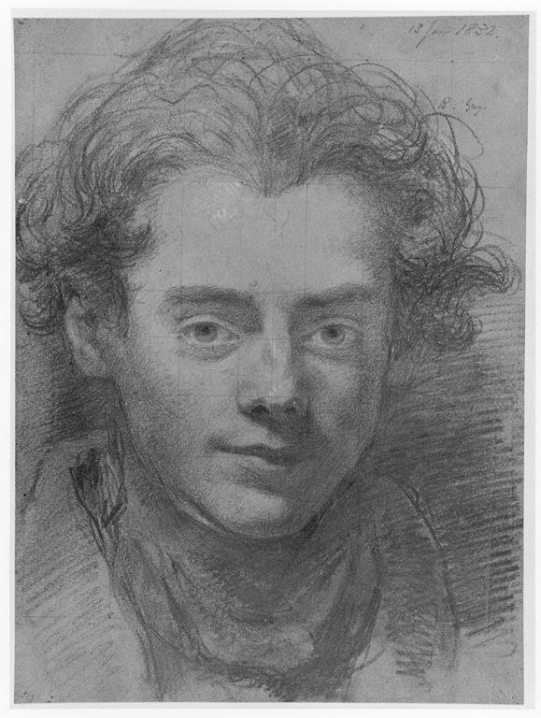
Notes:
Creator: William Bradley (1801-1857) Title: Portrait of Henry Liverseege Date: 1832 Material: graphite, heightened with white, touched with red and blue chalk, on grey-green pape Measurements: 338 x 248 mm Description: Dated: "13 Jan 1832" and inscribed: "R. Grey." Repository: British Museum Dept. of Prints and Drawings, 1908-6-6-1; British Museum Dept. of Prints and Drawings, 1946-7-13-279; British Museum Dept. of Prints and Drawings, 1853-8-13-25; British Museum Dept. of Prints and Drawings, 1946-7-13-279 Repository: http://www.britishmuseum.org/ Collection: Gernsheim Photographic Corpus of Drawings ID Number: 121909 Source: Image and original data provided by the Gernsheim Photographic Corpus of Drawings established in 1937 Rights: Please note that if this image is under copyright, you may need to contact one or more copyright owners for any use that is not permitted under the ARTstor Terms and Conditions of Use or not otherwise permitted by law. While ARTstor tries to update contact information, it cannot guarantee that such information is always accurate. Determining whether those permissions are necessary, and obtaining such permissions, is your sole responsibility.

Slide 44
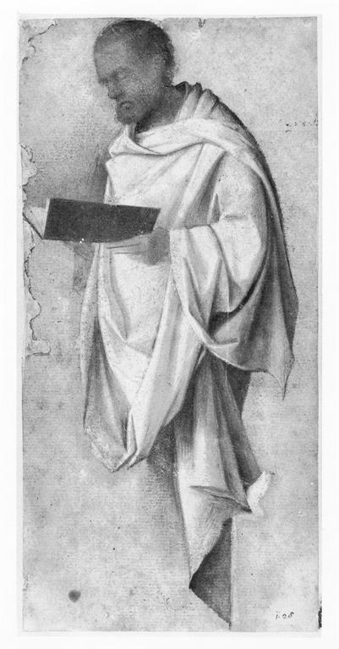
Notes:
Creator: Giovanni Bellini (1431-1436, died 1516) Title: Drapery study for a male saint Material: oil Measurements: 224 x 106 mm Description: Corresponds in reverse with the figure of St. Peter in the engraving by Mocetto 'Virgin enthroned with St. John the Baptist, St. Peter and three female saints' (Pass, V, p.136, 10) that must be related to a lost altarpiece by Giovanni Bellini. Lit: A.E. Popham and P. Pouncey, 'Italian drawings in the BM, the fourteenth and fifteenth centuries', London, 1950, I, no. 19, II, pl. XVII (with previous literature). Repository: British Museum. Dept. of Prints and Drawings, 1902-8-22-4 Repository: http://www.britishmuseum.org/ Collection: Gernsheim Photographic Corpus of Drawings ID Number: 37300 Source: Image and original data provided by the Gernsheim Photographic Corpus of Drawings established in 1937 Rights: Please note that if this image is under copyright, you may need to contact one or more copyright owners for any use that is not permitted under the ARTstor Terms and Conditions of Use or not otherwise permitted by law. While ARTstor tries to update contact information, it cannot guarantee that such information is always accurate. Determining whether those permissions are necessary, and obtaining such permissions, is your sole responsibility.

Slide 45
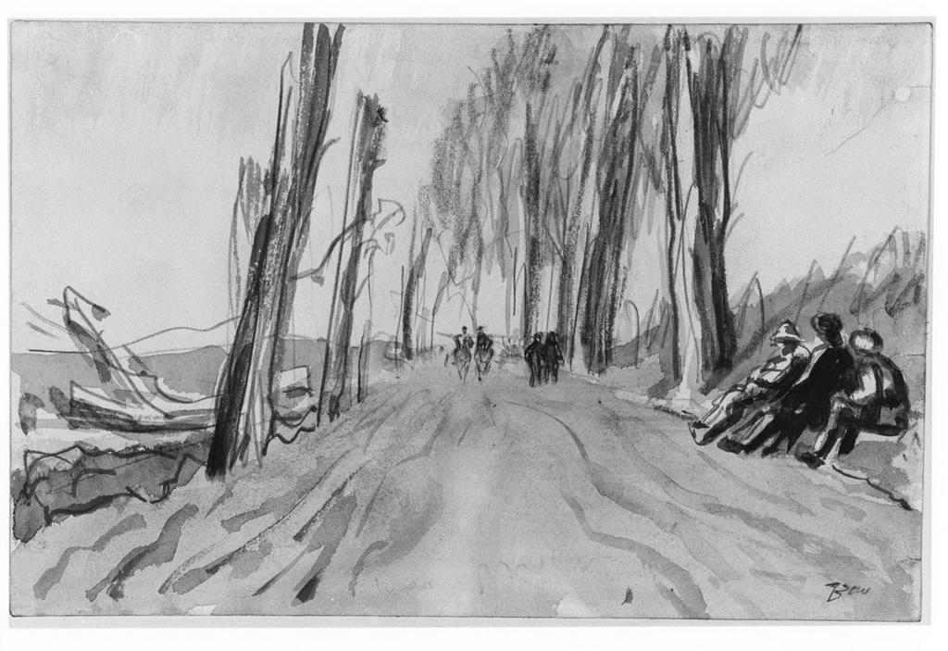
Notes:
Creator: Muirhead Bone (1876-1953) Title: The road to Maricourt Date: 1914-1918 Material: graphite and grey wash Measurements: 155 x 237 mm Description: Inscribed: "Bone" Repository: British Museum Dept. of Prints and Drawings, 1919-2-8-12 Repository: http://www.britishmuseum.org/ Collection: Gernsheim Photographic Corpus of Drawings ID Number: 145402 Source: Image and original data provided by the Gernsheim Photographic Corpus of Drawings established in 1937 Rights: Please note that if this image is under copyright, you may need to contact one or more copyright owners for any use that is not permitted under the ARTstor Terms and Conditions of Use or not otherwise permitted by law. While ARTstor tries to update contact information, it cannot guarantee that such information is always accurate. Determining whether those permissions are necessary, and obtaining such permissions, is your sole responsibility.

Slide 46
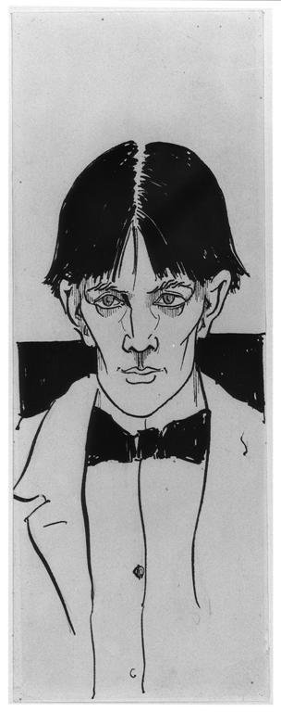
Notes:
Creator: Aubrey Vincent Beardsley (1872-1898) Title: Self-portrait Date: 1892 Material: pen and black ink, with black wash Measurements: 252 x 95 mm Description: This early self-portrait was not made for a particular publication, and was first reproduced after Beardsley's death in 'A Second Book of Drawings', London (Leonard Smithers) 1899, p.13. The donor, Robert Ross, was grandson of the first prime minister of Upper Canada, and a close friend of Beardsley whom he first met on 14 February 1892 (see 'Aubrey Beardsley', exhibition catalogue, Victoria & Albert Museum 1966, no.140). The drawing was probably made for him shortly afterwards. Ross published a famous biography of Beardsley in 1909 (where this drawing is no. 39 in the checklist), and was literary executor for Oscar Wilde. Repository: British Museum. Dept. of Prints and Drawings, 1906-4-23-1 Repository: http://www.britishmuseum.org/ Collection: Gernsheim Photographic Corpus of Drawings ID Number: 145394 Source: Image and original data provided by the Gernsheim Photographic Corpus of Drawings established in 1937 Rights: Please note that if this image is under copyright, you may need to contact one or more copyright owners for any use that is not permitted under the ARTstor Terms and Conditions of Use or not otherwise permitted by law. While ARTstor tries to update contact information, it cannot guarantee that such information is always accurate. Determining whether those permissions are necessary, and obtaining such permissions, is your sole responsibility.

Slide 47
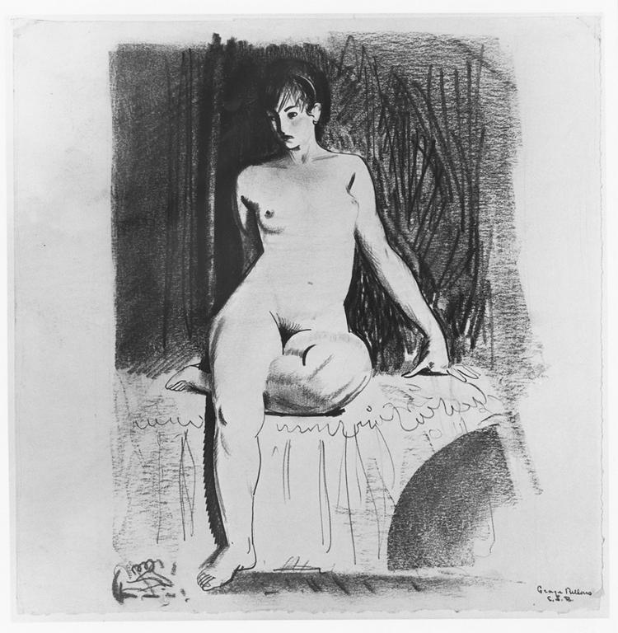
Notes:
Creator: George Wesley Bellows (1882-1925) Title: Nude girl seated on bed Material: black pen and chalk Measurements: 252 x 245 mm Repository: Cleveland Museum of Art; 1950.453 Repository: http://www.clemusart.com/ Collection: Gernsheim Photographic Corpus of Drawings ID Number: 98247 Source: Image and original data provided by the Gernsheim Photographic Corpus of Drawings established in 1937 Rights: Please note that if this image is under copyright, you may need to contact one or more copyright owners for any use that is not permitted under the ARTstor Terms and Conditions of Use or not otherwise permitted by law. While ARTstor tries to update contact information, it cannot guarantee that such information is always accurate. Determining whether those permissions are necessary, and obtaining such permissions, is your sole responsibility.

Slide 48
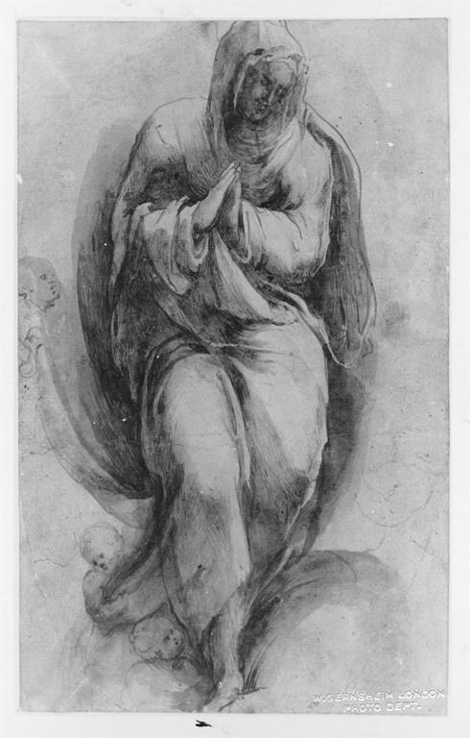
Notes:
Creator: Alonso Berruguete (ca. 1480 - 1561) Title: Assumption of the Virgin Material: brush drawing in brown ink, with pen and brown ink and brown wash, heightened with white (oxidised) Measurements: 313 x 193 mm Repository: British Museum. Dept. of Prints and Drawings, 1895-9-15-866 Repository: http://www.britishmuseum.org/ Collection: Gernsheim Photographic Corpus of Drawings ID Number: 5222 Source: Image and original data provided by the Gernsheim Photographic Corpus of Drawings established in 1937 Rights: Please note that if this image is under copyright, you may need to contact one or more copyright owners for any use that is not permitted under the ARTstor Terms and Conditions of Use or not otherwise permitted by law. While ARTstor tries to update contact information, it cannot guarantee that such information is always accurate. Determining whether those permissions are necessary, and obtaining such permissions, is your sole responsibility.

Slide 49
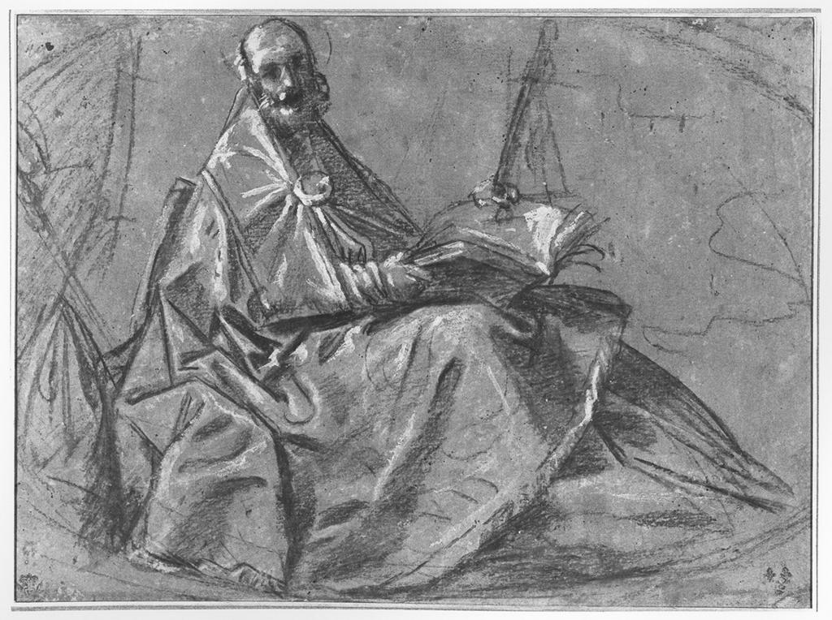
Notes:
Creator: Giacomo Cavedone (1577-1660) Title: Saint Ambrose Material: oily chalk heightened with white on brown paper Measurements: 284 x 390 mm Repository: Fogg Art Museum; 1957.134 (verso) Repository: http://www.artmuseums.harvard.edu/fogg/ Collection: Gernsheim Photographic Corpus of Drawings ID Number: 92625 Source: Image and original data provided by the Gernsheim Photographic Corpus of Drawings established in 1937 Rights: Please note that if this image is under copyright, you may need to contact one or more copyright owners for any use that is not permitted under the ARTstor Terms and Conditions of Use or not otherwise permitted by law. While ARTstor tries to update contact information, it cannot guarantee that such information is always accurate. Determining whether those permissions are necessary, and obtaining such permissions, is your sole responsibility.

Slide 50
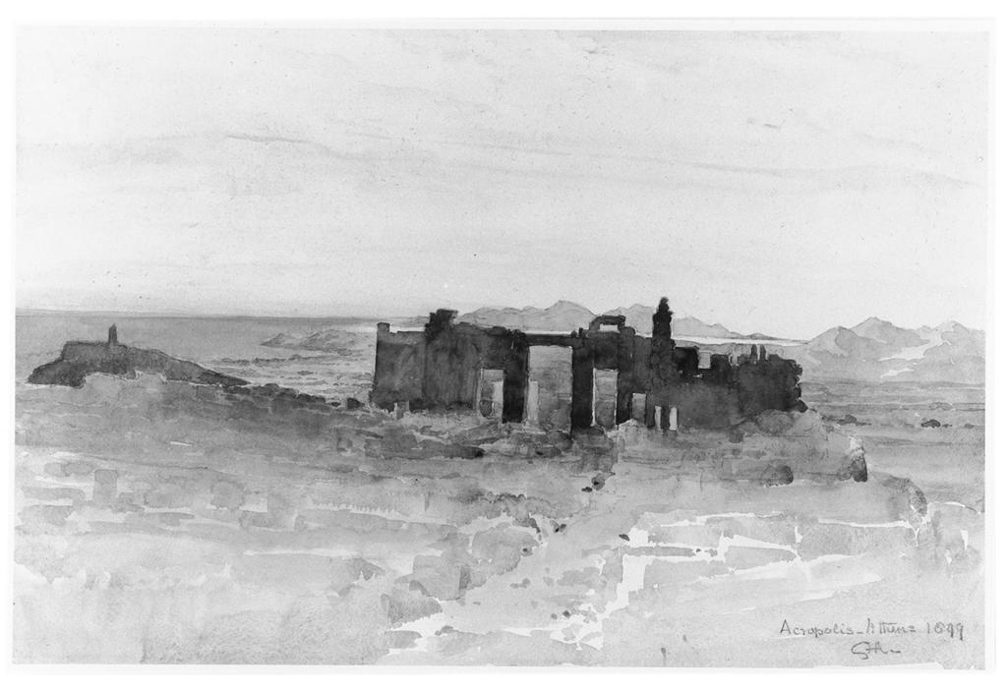
Notes:
Creator: Charles Hamilton Aïdé (1826-1906) Title: The Propylaea from the Parthenon, Athens Date: 1899 Material: watercolour Measurements: 348 x 529 Repository: British Museum. Dept. of Prints and Drawings, 1905-7-5-1 Repository: http://www.britishmuseum.org/ Collection: Gernsheim Photographic Corpus of Drawings ID Number: 143330 Source: Image and original data provided by the Gernsheim Photographic Corpus of Drawings established in 1937 Rights: Please note that if this image is under copyright, you may need to contact one or more copyright owners for any use that is not permitted under the ARTstor Terms and Conditions of Use or not otherwise permitted by law. While ARTstor tries to update contact information, it cannot guarantee that such information is always accurate. Determining whether those permissions are necessary, and obtaining such permissions, is your sole responsibility.

Slide 51
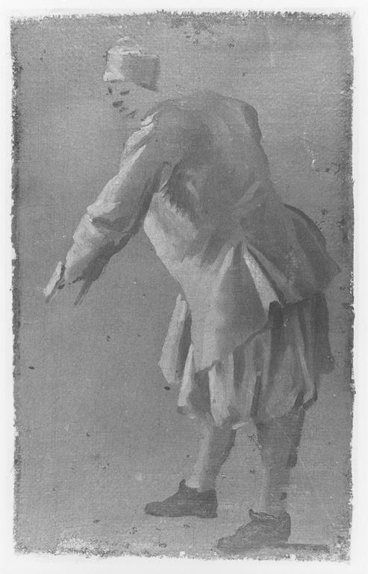
Notes:
Creator: Luca Carlevariis (1663-1729) Title: Venetian figure Material: oil on canvas Measurements: 185 x 112 mm Repository: Victoria and Albert Museum. Dept. of Prints and Drawings; P 46-1938 Repository: http://www.vam.ac.uk/ Collection: Gernsheim Photographic Corpus of Drawings ID Number: 100307 Source: Image and original data provided by the Gernsheim Photographic Corpus of Drawings established in 1937 Rights: Please note that if this image is under copyright, you may need to contact one or more copyright owners for any use that is not permitted under the ARTstor Terms and Conditions of Use or not otherwise permitted by law. While ARTstor tries to update contact information, it cannot guarantee that such information is always accurate. Determining whether those permissions are necessary, and obtaining such permissions, is your sole responsibility.

Slide 52
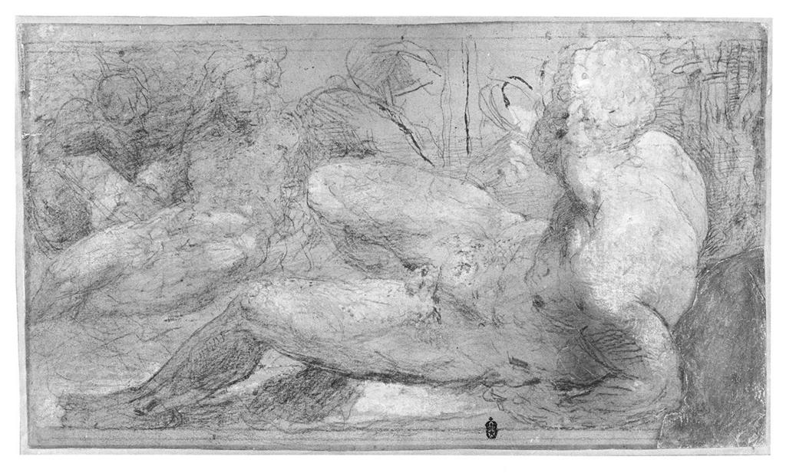
Notes:
Creator: Domenico Beccafumi (1486-1551) Title: Rivergods Material: black chalk heightened with white Measurements: 232 x 411 mm Repository: Cleveland Museum of Art; 1958.313 Repository: http://www.clemusart.com/ Collection: Gernsheim Photographic Corpus of Drawings ID Number: 90012 Source: Image and original data provided by the Gernsheim Photographic Corpus of Drawings established in 1937 Rights: Please note that if this image is under copyright, you may need to contact one or more copyright owners for any use that is not permitted under the ARTstor Terms and Conditions of Use or not otherwise permitted by law. While ARTstor tries to update contact information, it cannot guarantee that such information is always accurate. Determining whether those permissions are necessary, and obtaining such permissions, is your sole responsibility.

Slide 53
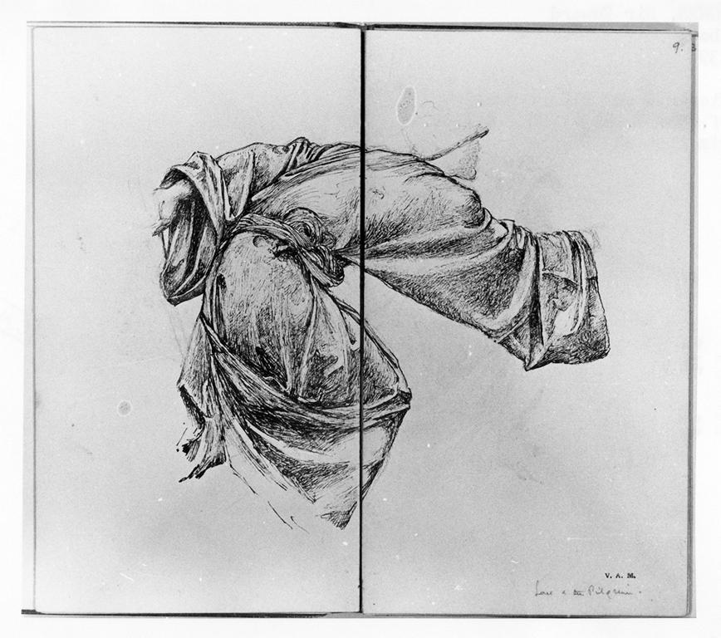
Notes:
Creator: Edward Burne-Jones (1833-1898) Title: Sketch-book, folio 8 (verso), folio 9 Material: pencil and leadpoint Measurements: each, 253 x 139 mm Repository: Victoria and Albert Museum. Dept. of Prints and Drawings; E. 1613-1926, fol.8 (verso), 9 Repository: http://www.vam.ac.uk/ Collection: Gernsheim Photographic Corpus of Drawings ID Number: 62340 Source: Image and original data provided by the Gernsheim Photographic Corpus of Drawings established in 1937 Rights: Please note that if this image is under copyright, you may need to contact one or more copyright owners for any use that is not permitted under the ARTstor Terms and Conditions of Use or not otherwise permitted by law. While ARTstor tries to update contact information, it cannot guarantee that such information is always accurate. Determining whether those permissions are necessary, and obtaining such permissions, is your sole responsibility.

Slide 54
Notes:
Creator: David Young Cameron (1865-1945) Title: Landscape with castle Material: charcoal on light yellow paper Measurements: 376 x 530 mm Repository: Cleveland Museum of Art; 1940.728 Repository: http://www.clemusart.com/ Collection: Gernsheim Photographic Corpus of Drawings ID Number: 87008 Source: Image and original data provided by the Gernsheim Photographic Corpus of Drawings established in 1937 Rights: Please note that if this image is under copyright, you may need to contact one or more copyright owners for any use that is not permitted under the ARTstor Terms and Conditions of Use or not otherwise permitted by law. While ARTstor tries to update contact information, it cannot guarantee that such information is always accurate. Determining whether those permissions are necessary, and obtaining such permissions, is your sole responsibility.

Slide 55
Notes:
Creator: David Young Cameron (1865-1945) Title: Landscape with castle Material: charcoal on light yellow paper Measurements: 376 x 530 mm Repository: Cleveland Museum of Art; 1940.728 Repository: http://www.clemusart.com/ Collection: Gernsheim Photographic Corpus of Drawings ID Number: 87008 Source: Image and original data provided by the Gernsheim Photographic Corpus of Drawings established in 1937 Rights: Please note that if this image is under copyright, you may need to contact one or more copyright owners for any use that is not permitted under the ARTstor Terms and Conditions of Use or not otherwise permitted by law. While ARTstor tries to update contact information, it cannot guarantee that such information is always accurate. Determining whether those permissions are necessary, and obtaining such permissions, is your sole responsibility.

Slide 56
Notes:
Creator: David Young Cameron (1865-1945) Title: Landscape with castle Material: charcoal on light yellow paper Measurements: 376 x 530 mm Repository: Cleveland Museum of Art; 1940.728 Repository: http://www.clemusart.com/ Collection: Gernsheim Photographic Corpus of Drawings ID Number: 87008 Source: Image and original data provided by the Gernsheim Photographic Corpus of Drawings established in 1937 Rights: Please note that if this image is under copyright, you may need to contact one or more copyright owners for any use that is not permitted under the ARTstor Terms and Conditions of Use or not otherwise permitted by law. While ARTstor tries to update contact information, it cannot guarantee that such information is always accurate. Determining whether those permissions are necessary, and obtaining such permissions, is your sole responsibility.

Slide 57
Notes:
Creator: David Young Cameron (1865-1945) Title: Landscape with castle Material: charcoal on light yellow paper Measurements: 376 x 530 mm Repository: Cleveland Museum of Art; 1940.728 Repository: http://www.clemusart.com/ Collection: Gernsheim Photographic Corpus of Drawings ID Number: 87008 Source: Image and original data provided by the Gernsheim Photographic Corpus of Drawings established in 1937 Rights: Please note that if this image is under copyright, you may need to contact one or more copyright owners for any use that is not permitted under the ARTstor Terms and Conditions of Use or not otherwise permitted by law. While ARTstor tries to update contact information, it cannot guarantee that such information is always accurate. Determining whether those permissions are necessary, and obtaining such permissions, is your sole responsibility.

Slide 58
Notes:
Creator: David Young Cameron (1865-1945) Title: Landscape with castle Material: charcoal on light yellow paper Measurements: 376 x 530 mm Repository: Cleveland Museum of Art; 1940.728 Repository: http://www.clemusart.com/ Collection: Gernsheim Photographic Corpus of Drawings ID Number: 87008 Source: Image and original data provided by the Gernsheim Photographic Corpus of Drawings established in 1937 Rights: Please note that if this image is under copyright, you may need to contact one or more copyright owners for any use that is not permitted under the ARTstor Terms and Conditions of Use or not otherwise permitted by law. While ARTstor tries to update contact information, it cannot guarantee that such information is always accurate. Determining whether those permissions are necessary, and obtaining such permissions, is your sole responsibility.

Slide 59
Notes:
Creator: David Young Cameron (1865-1945) Title: Landscape with castle Material: charcoal on light yellow paper Measurements: 376 x 530 mm Repository: Cleveland Museum of Art; 1940.728 Repository: http://www.clemusart.com/ Collection: Gernsheim Photographic Corpus of Drawings ID Number: 87008 Source: Image and original data provided by the Gernsheim Photographic Corpus of Drawings established in 1937 Rights: Please note that if this image is under copyright, you may need to contact one or more copyright owners for any use that is not permitted under the ARTstor Terms and Conditions of Use or not otherwise permitted by law. While ARTstor tries to update contact information, it cannot guarantee that such information is always accurate. Determining whether those permissions are necessary, and obtaining such permissions, is your sole responsibility.

Slide 60
The Built Works Registry and the Infrastructure to Support it
James Shulman
From, Philippine life in town and country: 1905.

Slide 61
The Barnes Foundation – 437 images live, 1,500 more to come
Notes:
Henri Matisse, 1869-1954 Title Reclining Nude with Blue Eyes (Nu couché aux yeux bleus) Date January 1936 Material Oil on canvas Measurements 13 x 18 1/8 in. (33 x 46 cm) Repository Barnes Foundation Accession Number BF955

Slide 62
African and African-American studies Christopher Roy and Herbert Cole: African field photography
Winiama mask performance (masks greet guests in the village), 2006. Ouri, Burkina Faso.Photographed by Christopher Roy.
Senufo, Pelerova Masker, 1979. Tiasso, Côte d'Ivoire. Photographed by Herbert Cole.

Slide 63
Magnum Photos – 80,000 photos of world events, people, places
(LEFT) Paolo Pellegrin: Muammar Qaddafi in his residential compound, Tripoli, Libya, 2002. (ABOVE) Philippe Halsman: Audrey HEPBURN posing for a LIFE Magazine cover, 1955.
Notes:
Creator: Paolo Pellegrin Title: LIBYA. 2002. Tripoli. Muammar Qaddafi in his residential compound. Date: 2002 Collection: Magnum Photos ID Number: PAR237579.jpg Source: Image and original data provided by Magnum Photos Source: http://www.magnumphotos.com/ Rights: ©Paolo Pellegrin / Magnum Photos Rights: Contact information: Mark Lubell, Bureau Chief, Magnum Photos, 151 West 25th Street, New York, New York 10001-7204 Rights: Please note that if this image is under copyright, you may need to contact one or more copyright owners for any use that is not permitted under the ARTstor Terms and Conditions of Use or not otherwise permitted by law. While ARTstor tries to update contact information, it cannot guarantee that such information is always accurate. Determining whether those permissions are necessary, and obtaining such permissions, is your sole responsibility.

Slide 64
ARTstor Digital Library Today
Founded by The Andrew W. Mellon Foundation in 2001
Independent nonprofit organization since 2003
Launched in July 1, 2004
1.5 million images and growing
200+ museum & special collections
Museums, archives, libraries, artists, artists’ estates, scholars, photographers
Password-protected database restricted to educational and scholarly users
Notes:
Jan VermeerTitleThe Painter and his Model as KlioDate1665-1666Materialoil on canvasMeasurements120 x 100 cmRepositoryKunsthistorisches Museum ViennaARTstor CollectionArt, Archaeology and Architecture (Erich Lessing Culture and Fine Arts Archives)ID Number40-03-01/50SourceImage and original data provided by Erich Lessing Culture and Fine Arts Archives/ART RESOURCE, N.Y. http://www.artres.com/c/htm/Home.aspx http://www.artres.com/c/htm/TreePfLight.aspx?ID=LES

